Slide 1
migrants in countries in crisis (MICIC) initiative
Minimizing Risks and Creating Safeguards
co-chaired by the Philippines and the United States

Slide 2
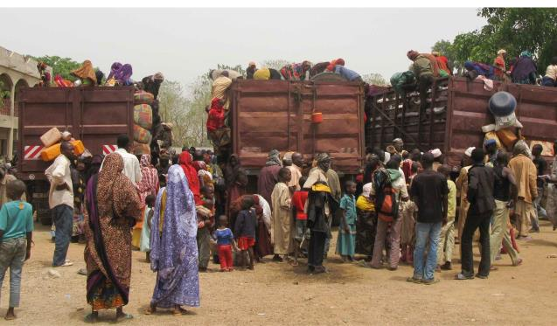
Overview of the MICIC Initiative
Origins
Objectives
Scope
Beneficiaries
Process
Stakeholders
Outcome

Slide 3
Recent Crises
2004 Asian Tsunami
2011Conflict in Libya
2011Tohoku Earthquake in Japan
2012 Hurricane Sandy in the U.S.
On-going Conflict in the Central African Republic (CAR)

Slide 4
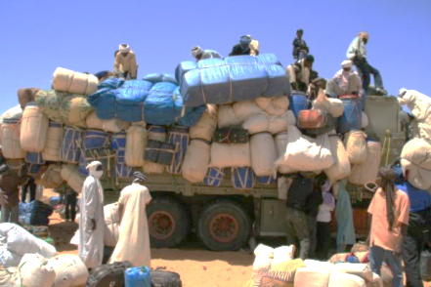
2011 Libya Crisis
February-June 2011civil strife
706,000 migrants fled Libya
Most were from neighboring countries – 45% were comprised of 120 nationalities
All in need of assistance; many in need of protection and evacuation
Impact:
Libyan economy adversely affected by the loss of foreign workers
Remittance flows abruptly cut
Return and reintegration challenges for home countries

Slide 5
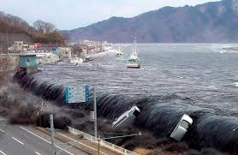
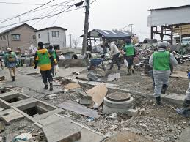
2011 Japan Disaster
2.1 million registered foreigners in Japan in 2011;
March 11, 2011 crisis (earthquake and tsunami) killed some 20,000 and displaced countless more;
531,000 foreigners, almost a quarter of those in Japan, left Japan in the month after the earthquake;
During the crisis, communication with
migrants was essential for emergency
assistance.

Slide 6
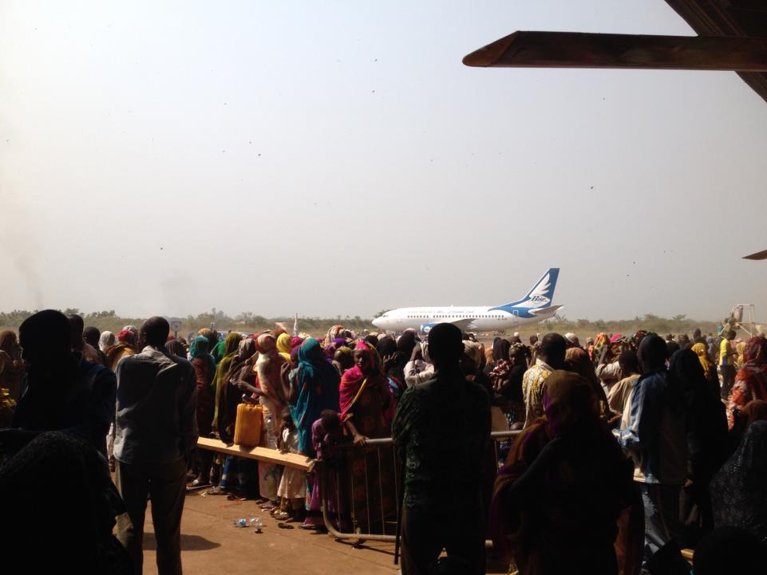
And CAR..
Ongoing Crisis in CAR
Migrants caught in the violence: many congregated near the airport in Bangui with the hope of evacuation.
Ongoing humanitarian assistance by the international community;
Distinct role of migrant population: commerce & major contributors to economy;
Targeted during critical escalation of violence from December 2013;
Sudden flow of returns (July 2014): 106,342 to Chad; 4,314 to Cameroon; 1,073 to other countries; unknown numbers to DRC and Congo.

Slide 7
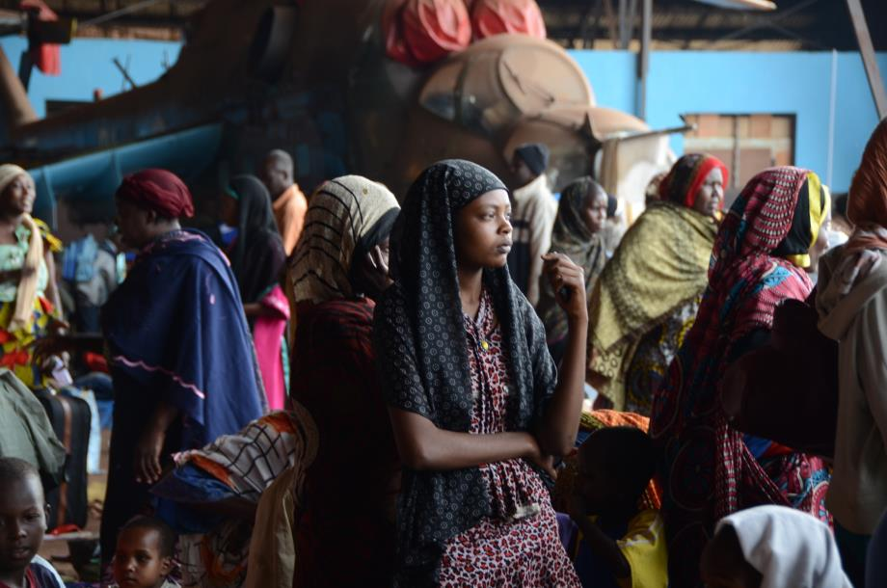
Migrants in countries in crisis: a collective responsibility

Slide 8
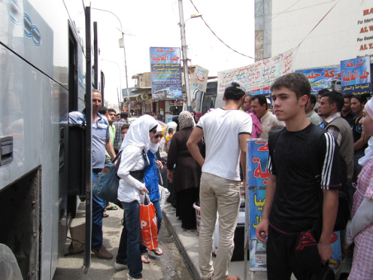
Origins of the MICIC Initiative
Migrants fall through the cracks when conflict or natural disasters hit host communities:
Attention called to this issue by SRSG Sutherland; IOM; IGC Theme 2010-2011; UN HLD 2013;
State-led response
needed to:
Increase Protection
Decrease Vulnerability

Slide 9
Why Migrants?
Migrants face specific challenges when crises hit and they:
Are not included in emergency plans,
Lack access to information,
Experience language barriers,
Lack access to identity documentation,
Lack access to consular services,
Lack access to evacuation and reintegration services, etc.

Slide 10
Overall Objective: Save Lives, Improve Responses
Better preparation > reduce vulnerability
More effective response > save lives, improve protection and assistance
Better recovery > improve human and societal development outcomes

Slide 11
Process
State-led inclusive consultation process to produce voluntary, non-binding guidelines and identify effective practices to reduce vulnerability, save lives, and enhance protection and assistance
Will define the issues and collect the evidence base;
Examine roles and responsibilities of States (of origin, transit, and hosting) and other stakeholders, i.e. employers, IO’s, civil society;
Identify specific practical measures that can be taken to prepare for, respond to and better protect the lives, rights and dignity of migrants caught in countries in crisis.

Slide 12
Leadership
Co-Chairs: Governments of the Philippines and the United States
Working Group:
Governments: Australia, Bangladesh, Costa Rica, Ethiopia, the European Union, Philippines, the United States
International Organizations and Experts: IOM, UNHCR, SRSG on International Migration and Development, Georgetown University Institute for the Study of International Migration
Secretariat headed by IOM

Slide 13
Scope
Which migrants? Migrants caught in countries in crisis
While other migrants can be extremely vulnerable and their lives or rights at risk, the focus of this initiative is limited to this extreme situation;
Those already in the country when the crisis hits, regardless of immigration status; not migrants in transit or seeking entry.
What types of crises? natural disasters or conflict; not simply challenging economic, employment or living circumstances.
Which phases? Pre-crisis, during the crisis, and post-crisis.

Slide 14
While the MICIC Initiative is targeted to specific situations:
The MICIC Initiative outcome will be useful for States in addressing a broader range of migratory scenarios;
Different types of planning and responses will be needed for migrants and situations that are not covered by the MICIC Initiative, due to the need for tailored approaches.

Slide 15
Who are the beneficiaries?
Migrants in the country in crisis with no means to get safely home: migrants & their families, including tourists, business travelers, foreign students, marriage migrants, victims of trafficking and smuggled migrants, etc.
with and without legal status in the country;
present in the country temporarily or permanently but who are not citizens;
with special attention to the most vulnerable: women, children, elderly and disabled persons;
this initiative will not take the place of existing refugee protections.

Slide 16
Consultations
Regional Consultations: Sponsored by the EC
West and Central Africa
Southern Mediterranean and Middle East
South and Southeast Asia
Latin America
Eastern and Southern Africa
Eastern Europe and Central Asia
Other thematic and multistakeholder consultations:
Regional Consultative Processes on Migration (RCPs)
Global Forum on Migration and Development (GFMD)
World Humanitarian Summit (WHS)
Expert thematic consultations
International organizations, civil society, private sector

Slide 17
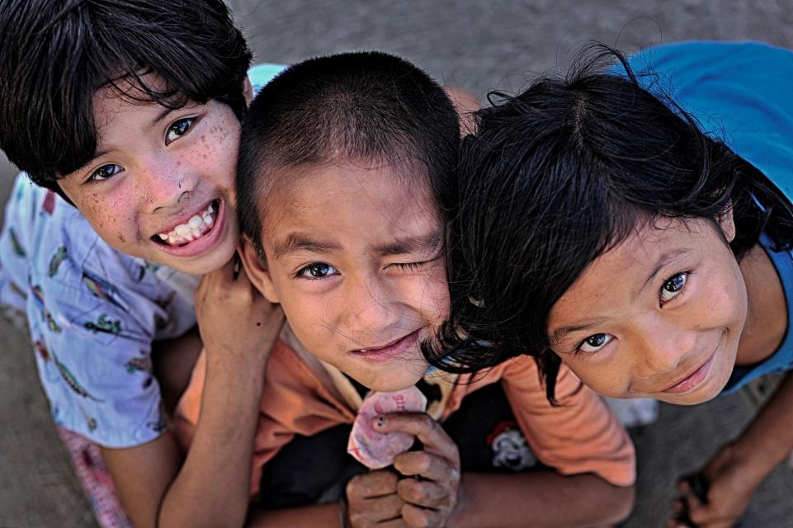
Join the discussion to find creative solutions
for migrants caught in countries in crisis
Keep informed:
http://www.iom.int/cms/micic

