Slide 1
Regional Conference on Migration (RCM) Unscrupulous Immigration Consultant Workshop December 15-17, 2014 Guatemala City, Guatemala
Canada Border Services Agency (CBSA)

Slide 2
The Canada Border Services Agency
Ensures the security and prosperity of Canada by managing the access of people and goods to and from Canada
13,000 employees including over 7,200 uniformed CBSA officers
1,200 locations across Canada - 119 land-border crossings and 13 international airports
39 international locations

Slide 3
Immigration Fraud
Historically, irregular migration to Canada was largely based on migrants exploiting our generous refugee processes. Facilitators were often involved in obtaining false documents for their clients to facilitate their travel and in providing false information in support of their refugee claims.
As the security of travel documents has increased and airlines and border authorities scrutinize passports more carefully, we have seen a global decline in the detection of fraudulent travel documents; however, facilitators are now targeting legitimate processes (i.e. obtaining false identity documents to support visa applications for their clients, providing false job offers to support temporary or permanent residents entry).
The flow of migrants across borders is controlled increasingly by criminal networks. Due to more restrictive immigration policies in destination countries and improved technology to monitor border crossings, willing illegal migrants rely increasingly on the help of organized people smugglers.

Slide 4
CBSA's Enforcement and Intelligence Capacity
Investigation and enforcement under the Customs Act (CA) and the Immigration and Refugee Protection Act (IRPA)
Intelligence (collection and analysis of information in support of IRPA and CA administration and enforcement)
Inland Enforcement (arrest, detention, removal under IRPA regulatory provisions)
Criminal Investigations (investigation and criminal prosecution under IRPA and the CA)
4
Notes:
4

Slide 5
CBSA's Enforcement and Intelligence Priorities
Contraband | Trade Fraud, Drugs, Firearms, Currency, Tobacco
Immigration Fraud | Residence Fraud, Consultant Fraud, Marriage of Convenience, Welfare/Benefit Fraud, Employment Fraud
Irregular Migration | Smuggling, Trafficking, Removals
National Security | Terrorism, Inadmissibility, Counter-proliferation
Activities are conducted across the continuum of pre-border, at the border and in country
5
Notes:
5

Slide 6
IRPA Consultant Offences
There are two sections of the IRPA that primarily address illegal consultant offences:
Counselling misrepresentation: Every person who knowingly counsels, induces, aids or abets or attempts to counsel, induce, aid or abet any person to directly or indirectly misrepresent or withhold material facts relating to a relevant matter that induces or could induce an error in the administration of this Act is guilty of an offence.
Indictment = <$100K and/or < 5 years
Summary = <$50K and/or < 2 years
Representation or advice for consideration: No person shall knowingly, directly or indirectly, represent or advise a person for consideration — or offer to do so — in connection with a proceeding or application under this Act.
Indictment = <$100K and/or < 2 years
Summary = <$20K and/or < 6 months

Slide 7
Criminal Investigative Process
Investigations of consultant fraud are complex, lengthy and resource-intensive.
Often initiated as a result of a referral of information from intelligence, CIC, members of the public or the Immigration Consultants of Canada Regulatory Council (ICCRC).
Collection of evidence includes:
Execution of search warrants
Interviews of multiple individuals
Surveillance operations to obtain evidence
Priorities are established based on the urgency of the case, availability of evidence, and the public’s interest to proceed, including considering aggravating factors.
Cases are then referred to the Public Prosecution Service of Canada (PPSC) for prosecution.
The duration of a case from investigation to prosecution can take from two to five years.

Slide 8
Consultant Fraud Investigations Statistics January 2008 to November 2014
Referrals Received (all sources) | 869
Cases Opened | 203
Cased Closed (with no charges laid) | 100
Charges Laid Guilty Convictions Charges Withdrawn Cases still before the Courts | 28 16 1 11
Cases still under Investigation | 75
8
Notes:
8

Slide 9
Challenges of prosecuting consultant offences
Referrals may not contain sufficient information to initiate an investigation; a higher test of evidence is required in criminal proceedings.
Evidence on application files may have been destroyed by the time the investigation is initiated.
Migrants are reluctant to report offences for fear of incriminating themselves or for fear that they will be removed from Canada.
Consultants operating outside of Canada - Canadian legislation cannot be applied and the activity may not be illegal in the other country.
Clients making false accusations due to negative application results.

Slide 10
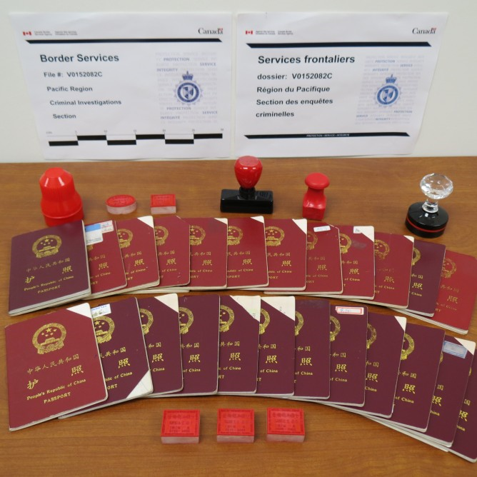
Success Stories
Immigration Fraud
On October 15, 2014, Mr. Xun Wang, the
owner of two unlicensed immigration
consulting businesses in Metro Vancouver,
was charged with multiple counts of fraud.
The CBSA has confirmed that Mr. Wang was
charged with 6 immigration and 4 criminal
code offences in relation to 165 cases.
Charges were laid after a lengthy
investigation.
Mr. Wang advised foreign nationals to
provide misleading or false statements on
their permanent resident card renewal
applications in order to help his clients
maintain fictitious permanent resident status
and obtain Canadian citizenship
Mr. Wang was also charged with 1 count of
tax evasion and 2 counts of fraudulently
obtaining refunds or credits following an
independent probe by the Canada Revenue
Agency.

Slide 11
Success Stories
Counselling Misrepresentation
On December 2, 2014, at the Superior Court of Justice, Ms. Wei REN, also known as Christine Molson, pleaded guilty to 5 counts of counselling misrepresentation under Section 126 of IRPA.
The sentencing hearing is scheduled for March 13, 2015, at which time the prosecution is seeking a 2.5 year term of imprisonment.
Marrriage of Convenience
On January 16, 2014, Mr. Amadou Niang was convicted and fined $42,000 and sentenced to 2 years less a day to be served in the community. Mr. Niang was charged with 42 related charges in March 2010.
Police allege that Mr. Niang, a bogus immigration consultant, was the mastermind behind a marriage of convenience scheme which potentially involved 630 people and 315 suspicious marriages.

Slide 12
Going Forward
Strengthen partnerships – domestic and international
Increase the quality of referrals – referral guidelines to assist partners
Ensure intelligence focus on immigration fraud
Our ability to identify and take action against immigration fraud is essential to meeting our public safety and national security mandate as well as ensuring public trust in our immigration system.

