Slide 1
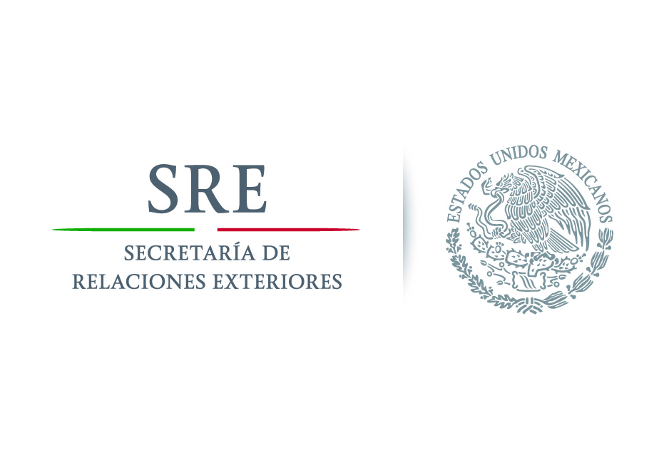
Protocol of Consular Assistance for Victims of Gender-based Violence
GENERAL OFFICE OF PROTECTION FOR MEXICANS ABROAD
Avenida Juárez núm. 20, Col. Centro, Del. Cuauhtémoc, , C.P. 06010, México, D.F.,
Tels.: (55) 3686 - 5100 http://www.sre.gob.mx
29

Slide 2
GENERAL OFFICE OF PROTECTION FOR MEXICANS ABROAD
UN Women and the Secretariat of Foreign Affairs of the Government of Mexico are jointly developing the project “Protocol of Consular Assistance for Women Victims of Violence” with the aim creating an instrument to strengthen the actions of consular officers, ensure the rights of the target population and comply with national and international obligations of the State of Mexico concerning equality and –non-discrimination.
Avenida Juárez núm. 20, Col. Centro, Del. Cuauhtémoc, , C.P. 06010, México, D.F.,
Tels.: (55) 3686 - 5100 http://www.sre.gob.mx
30

Slide 3
GENERAL OFFICE OF PROTECTION FOR MEXICANS ABROAD
The project is framed wtihin the gender agenda of the Secretariat of Foreign Affairs to stimulate actions oriented toward providing tools to consulates under the principle of gender equality and non-discrimination. This protocol is a strategic reference document for the institutional efforts of the Secretariat to foster substantive equality for women and prevent and combat all forms of discrimination and gender-based violence.
Avenida Juárez núm. 20, Col. Centro, Del. Cuauhtémoc, , C.P. 06010, México, D.F.,
Tels.: (55) 3686 - 5100 http://www.sre.gob.mx
30

Slide 4
GENERAL OFFICE OF PROTECTION FOR MEXICANS ABROAD
What is the purpose of the Protocol?
It is a tool for consulates to help them ensure that comprehensive assistance is provided to migrant women and girls victims of gender-based violence.
It involves a new consular assistance model that seeks to provide specialized assistance through identifying the specific needs of the population served.
It has been designed as a useful tool to identify potential violence against migrant women and girls of the population served, and as a guidance document for preventative policy.
Avenida Juárez núm. 20, Col. Centro, Del. Cuauhtémoc, , C.P. 06010, México, D.F.,
Tels.: (55) 3686 - 5100 http://www.sre.gob.mx
30

Slide 5
GENERAL OFFICE OF PROTECTION FOR MEXICANS ABROAD
Why was the Protocol developed?
Migrant women and girls in the USA face multiple situations of discrimination and violence. Violence against women is a serious human rights violation and a global emergency, which is perpetuated in contexts of systematic social tolerance. At a global level, an estimated 35% of all women have suffered physical and/or sexual violence by their partners or a person other than the partner at some point in their lives. Physical, psychological and economic violence against women occurs in the public as well as the private sphere. This violence is experienced continuously and is exacerbated in crisis situations such as natural disasters, armed conflict and migration.
Avenida Juárez núm. 20, Col. Centro, Del. Cuauhtémoc, , C.P. 06010, México, D.F.,
Tels.: (55) 3686 - 5100 http://www.sre.gob.mx
30

Slide 6
GENERAL OFFICE OF PROTECTION FOR MEXICANS ABROAD
How does the Protocol work?
It provides information for consular officers on what to do, how and why in providing assistance to women victims of any form of violence.
The document is accompanied by an easily accessible and user-friendly “tool box” for consular staff. The Protocol especially highlights awareness-raising of consular officers and the adoption of a policy of strict confidentiality to ensure the security of women and girls victims of gender-based violence.
The Protocol replaces the traditional interview with an interactive dialogue based on the model of “informing in order to ask”. With this method, the necessary information for an initial risk assessment is obtained to help identify cases of victims of gender-based violence.
Avenida Juárez núm. 20, Col. Centro, Del. Cuauhtémoc, , C.P. 06010, México, D.F.,
Tels.: (55) 3686 - 5100 http://www.sre.gob.mx
30

Slide 7
GENERAL OFFICE OF PROTECTION FOR MEXICANS ABROAD
Based on a prior assessment of the consular assistance provided in the US and of consular programmes;
A tool that can be used by any consular office around the world;
Its main focus is on women, since they are the population group that most often experiences violence;
The term “women” that is used includes girls, female adolescents and adult women;
The definition, types and modes of gender-based violence are based on those established in international instruments and the General Law on Women’s Access to a Life Free of Violence (LGAMVLV);
Does not address the issue of trafficking in persons.
Avenida Juárez núm. 20, Col. Centro, Del. Cuauhtémoc, , C.P. 06010, México, D.F.,
Tels.: (55) 3686 - 5100 http://www.sre.gob.mx
30

Slide 8
GENERAL OFFICE OF PROTECTION FOR MEXICANS ABROAD
Stage | Step
Strengthening consular actions | Step 1: Assessing the context of violence in the area served by the consulate;
 | Step 2: Establishing a baseline;
 | Step 3: Adapting facilities;
 | Step 4: Developing a plan for coordination between consular areas and offices – Window for Comprehensive Assistance to Women (VAIM);
 | Step 5: Establishing a network of specialized services.
Avenida Juárez núm. 20, Col. Centro, Del. Cuauhtémoc, , C.P. 06010, México, D.F.,
Tels.: (55) 3686 - 5100 http://www.sre.gob.mx
30

Slide 9
GENERAL OFFICE OF PROTECTION FOR MEXICANS ABROAD
Stage | Step
Detection | A Single Step: Determining the appropriate body and/or programme for the detection of gender-based violence for each case.
Assistance | Step 1: Determining the body and/or programme in charge of providing assistance to women victims of violence;
 | Step 2: Identifying the needs of the women victims of violence requiring assistance.
Avenida Juárez núm. 20, Col. Centro, Del. Cuauhtémoc, , C.P. 06010, México, D.F.,
Tels.: (55) 3686 - 5100 http://www.sre.gob.mx
30

Slide 10
GENERAL OFFICE OF PROTECTION FOR MEXICANS ABROAD
FOR THE GENERAL OFFICE OF PROTECTION FOR MEXICANS ABROAD –DGPME
Minimum elements for a training and awareness-plan;
Features of the case registration system;
Types of dissemination materials.
FOR CONSULAR STAFF
Appropriate facilities for providing comprehensive assistance;
A plan for internal coordination between consular areas and consulates;
Training and updating of support networks.
Avenida Juárez núm. 20, Col. Centro, Del. Cuauhtémoc, , C.P. 06010, México, D.F.,
Tels.: (55) 3686 - 5100 http://www.sre.gob.mx
30

Slide 11
Assistance Tools
GENERAL OFFICE OF PROTECTION FOR MEXICANS ABROAD
Interview Guide
Guidance for initial emotional support and crisis management;
Guidance for risk and danger assessment;
Recommendations for self-care of consular officers.
Guidance for actions to assist persons in vulnerable situations who are dependents of women victims of violence;
Guidance for actions to assist women in highly vulnerable situations;
Guidance for referral to specialized services.
Avenida Juárez núm. 20, Col. Centro, Del. Cuauhtémoc, , C.P. 06010, México, D.F.,
Tels.: (55) 3686 - 5100 http://www.sre.gob.mx
30

Slide 12
Assistance Tools
GENERAL OFFICE OF PROTECTION FOR MEXICANS ABROAD
What questions NOT to ask “Why do you think that this happened to you?” Searching for causes of the problem serves no useful purpose. In addition, it can lead to revictimization. “Why didn’t you ask for assistance before?” Something that the person did not know how to handle before may cause feelings of guilt. What is important is that the person is seeking assistance now, and it should be provided. “Do you think that you could have defended yourself?” This is another question that causes feelings of guilt and possibly, helplessness. In addition, it could be a closed question. “You don’t need to cry, everything will work out.” This disqualifies the feelings of the person, and in addition, we don’t know what will happen in the future. “Why haven’t you left the person who attacks you?” An endless number of reasons exist to maintain a relationship where one of the partners is violent. Any decision will have side effects. Therefore, it is necessary to gain a contextual perspective of each case to be able to take action. The interview includes comprehensive information about what each decision would involve. Therefore, any process should be implemented together and in collaboration with the victim.
Avenida Juárez núm. 20, Col. Centro, Del. Cuauhtémoc, , C.P. 06010, México, D.F.,
Tels.: (55) 3686 - 5100 http://www.sre.gob.mx
30

Slide 13
Assistance Tools
GENERAL OFFICE OF PROTECTION FOR MEXICANS ABROAD
What NOT to do in situations requiring emotional support and crisis management Treating the woman victim of violence from a position of power, thinking that we have all information before verifying this with her in order to know what to do. For example, taking action without consulting with her. Treating the woman victim of violence as guilty of the situation she is experiencing. This would be revictimizing her instead of supporting her in the process. Getting upset when we provide assistance to a woman victim of violence who seems to be in a crisis situation. If consular officers do not feel prepared to act in a crisis situation, contact information should be readily available of specialized staff that can accompany the woman and to whom she should be referred. Promising the woman victim of violence that any situation she is experiencing will be resolved, without considering the scope of the actions of consular staff and the implications of each decision for the woman’s life. Disregarding situations where women have been injured by their aggressors. Some injuries could be serious or proof of a crime. It is important not to underestimate this situation and to refer the victim immediately. Referring the woman victim of violence without providing to her, step by step, the information she needs. Before referring her to any specialist or network of specialized services, she needs to understand clearly the steps she needs to take.
Avenida Juárez núm. 20, Col. Centro, Del. Cuauhtémoc, , C.P. 06010, México, D.F.,
Tels.: (55) 3686 - 5100 http://www.sre.gob.mx
30

Slide 14
GENERAL OFFICE OF PROTECTION FOR MEXICANS ABROAD
Detection Tools
Key message for detection
Questions for detection
Detection form
Avenida Juárez núm. 20, Col. Centro, Del. Cuauhtémoc, , C.P. 06010, México, D.F.,
Tels.: (55) 3686 - 5100 http://www.sre.gob.mx
30

Slide 15
Detection Tools
GENERAL OFFICE OF PROTECTION FOR MEXICANS ABROAD
OBSERVING THE WOMAN VICTIM OF VIOLENCE
Physical Aspects | Emotional Aspects, Attitude
Does she require health care? Does she have visible injuries or bruises? Does she have difficulty walking? Does she have difficulty breathing? Does she look tired? Is she visibly sleepy? | How is her posture and movement? Is she hunched? Is she shy or insecure? Is she able to maintain a coherent conversation? Does she look frightened? How is her tone of voice? Does she need to recover emotionally? Does she look anxious or nervous? Does she look sad or as if she has cried? Does she look unkempt?
Avenida Juárez núm. 20, Col. Centro, Del. Cuauhtémoc, , C.P. 06010, México, D.F.,
Tels.: (55) 3686 - 5100 http://www.sre.gob.mx
30

Slide 16
Detection Tools
GENERAL OFFICE OF PROTECTION FOR MEXICANS ABROAD
Specific questions, by type and sphere of violence 1. DOMESTIC VIOLENCE
Psychological or emotional domestic violence
1. Have you ever felt emotionally or psychologically hurt by your partner or a person who is close or important to you? (For example: constant insults, humiliation at home or in public, destruction of objects you felt close to, ridicule, rejection, manipulation, threats, isolation from friends or family members, etc.) 2. When did this happen? 3. Who did it?
Physical violence
1. Has your partner or a person close or important to you hurt you physically? (For example: beating, kicking, burning, etc.) 2. When did this happen? 3. Who did it?
Sexual violence
1. Have you ever felt forced to have sexual contact or relations? 2. When did this happen? 3. Who did it?
Sexual abuse during childhood
1. Do you remember having been touched by someone in an inappropriate manner when you were a child? 2. When did this happen? 3. Who did it?
Economic/patrimony violence 1. Does your partner or another person control your job income? 2. Does your partner or another person condition your access to the family income? 3. Has your partner or another person damaged, destroyed, removed, transformed or retained your personal identity documents or goods and assets that you own or that are of common ownership? 4. When did this happen? 5. Who did it?
Systematic security questions Do you feel safe to return home today? Are you afraid that your partner or another person could harm you?
30

Slide 17
GENERAL OFFICE OF PROTECTION FOR MEXICANS ABROAD
Prevention and Communication
A situation of violence in the area served by the consulate;
How to report it to the consulate and the services provided by the consulate;
Reporting the situation does not involve the risk of being deported, losing their job or being separated from their children;
Reporting the situation of violence could lead to benefits relating to migration;
A culture of non-violence.
Avenida Juárez núm. 20, Col. Centro, Del. Cuauhtémoc, , C.P. 06010, México, D.F.,
Tels.: (55) 3686 - 5100 http://www.sre.gob.mx
30

