Slide 1
The
(We are Mexicans)
Strategy

Slide 2
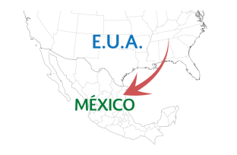
Problems we are facing
Some Mexicans have lived in the United States for many years, since they were young or as adults. They could be – or are – repatriated voluntarily or against their will.
Upon their return…
They do not identify ties with Mexico anymore.
They do not know anything about their rights as Mexicans:
They suffer discrimination.
They do not have a social network (community networks).
The do not know anything about the actions of the government.
Health
Housing
Education
Work

Slide 3
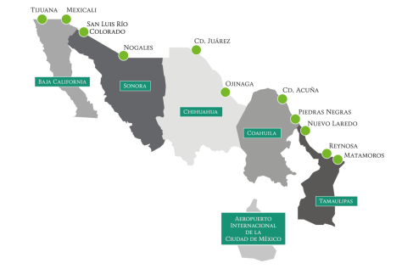
The problems we are facing
Year after year, Mexicans are returned from the United States against their will, through the repatriation modules of the National Institute of Migration located at the northern border and at the International Airport in Mexico City.
In addition, a significant number of Mexicans return to the country in a voluntary manner.
Layers of vulnerability in repatriation
Work
Vulnerability
Health
Housing
Education

Slide 4
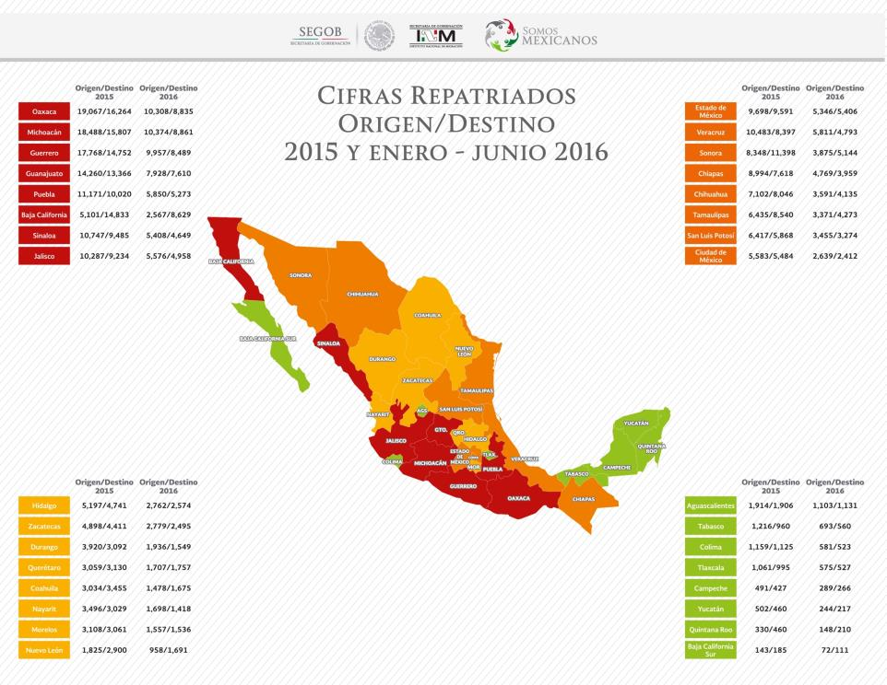
Repatriated Mexicans
Origin/Destination
2015 and January-June 2016

Slide 5
Why was the Somos Mexicanos Strategy established?
By law, and because the the State of Mexico prioritizes addressing the issue of the return of Mexicans.
PROGRAMMATIC SUPPORT
LEGAL SUPPORT
National Development Plan
Sectorial Programme of the Secretariat of the Interior
Special Migration Programme
Strategic Plan of INM
Migration Law
General Population Act

Slide 6
What is the Somos Mexicanos Strategy?
The Somos Mexicanos Strategy is an initiative of the Secretariat of the Interior implemented by the National Institute of Migration since March 26, 2014.
O B J E C T I V E
To provide comprehensive assistance to returning Mexicans, through an inter-institutional coordinated model, to enable them to contribute to the national development of Mexico in the short term.
M I S S I O N
V I S I O N
To facilitate the social and economic integration of Mexicans repatriated from the United States, ensuring that their return to the country is dignified, productive and in compliance with fundamental human rights principles. The above through joined efforts by the three levels of government as well as civil society, international organizations and foundations to address this situation experienced in our country.
To be consolidated as a comprehensive and effective system that integrates the actions of national institutions and organizations involved in carrying out efforts to benefit the integration and family well-being of repatriated Mexican migrants and thus, enable them to contribute to regional and national development.

Slide 7
Actions to be implemented by the
Secretariat of Foreign Affairs
Preventative advice and guidance for returned Mexicans;
Recovery of personal belongings;
Legal aid.
Consular assistance to deported Mexicans;
How is this done?
Through the Consular Network, Protection for Mexicans Abroad, the Institute for Mexicans Abroad and delegations in the United States and Mexico.

Slide 8
Actions to be implemented by SEGOB/ INM
INM implements actions, efforts and good offices to work in coordination with:
The 3 levels of government:
federal, state and municipal
Civil society organizations
Offices for assistance to migrants in the states
The private sector
Through the Federal Delegations in the Mexican Republic, and through Assistance for Repatriated Mexicans in the modules located at the northern border.

Slide 9
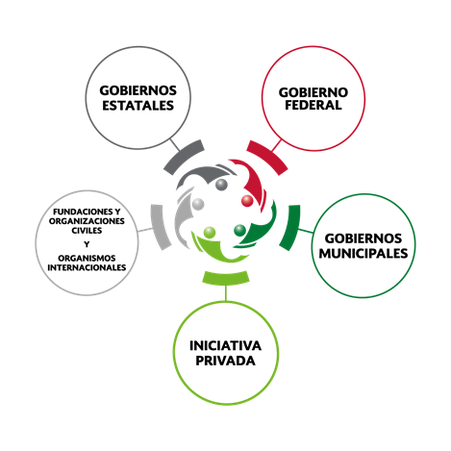
Reception and Reintegration – Services and Support
RECEPTION
The staff of the Somos Mexicanos Strategy is in charge of this.
SERVICES AND SUPPORT:
The services and support provided to repatriated Mexicans include the following:
Basic food and health care;
Identity (issuance of a proof of repatriation and an Individual Registration Number – CURP);
Communication (telephone calls to contact family members);
Urban transport and support for interstate transport;
Shelter (if required);
Work options;
Access to social programmes.
REINTEGRATION
The reintegration of repatriated persons into their communities of origin or destination is implemented together with:
STATE
GOVERN-
MENTS
FEDERAL GOVERN-MENT
FOUNDATIONS, CIVIL SOCIETY ORGANIZATIONS AND INTERNATIONAL ORGANIZATIONS
MUNICIPAL
GOVERN-
MENTS
THE PRIVATE SECTOR

Slide 10
Actions to be implemented by INM and OFAM
In countries of origin or destination
Accompaniment to ensure access to different types of institutional support and programmes
Guidance
Referral
Services and Support
Recovering personal belongings;
Employment agency;
Health care;
Social and self-employment programmes;
Alternatives for further education.

Slide 11
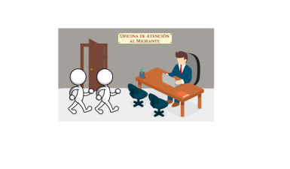
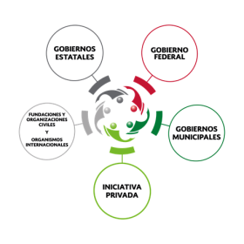
Inter-institutional coordination, mainly with Offices for Assistance to Migrants at the state level
National Institute of Migration
Finally I am with my family!
Reception and guidance
Referral or assistance

Slide 12
Coordination and implementation of actions at the central level
Formulates agreements and recommendations
Federal government
Central Coordination Group
Private sector
Establishes work agendas
Objective:
To identify government programmes and actions.
Civil society organizations

Slide 13
Local coordination in the delegations of the INM
Actions emanated from the
Central Coordination Agreement
State and municipal governments
Formulates agreements and recommendations
Federal delegates of INM lead the local working group
Private sector
Establishes work agendas
Delegations of federal institutions in states
Objective:
To identify government programmes and actions.
Civil society organizations

Slide 14
Coordinación local en las Delegaciones del INM
Main municipalities of origin of repatriated Mexicans from the state of Guanajuato
(January-July 2016)

Slide 15
Thank you for your attention!

