Slide 1
Second Meeting of the Ad Hoc Group on Migrant Boys, Girls and Adolescents
Comprehensive Assistance to Migrant Families, Boys, Girls and Adolescents Returning to the Northern Triangle Countries in Central America
International Organization for Migration
Mexico City, April 15-16, 2015

Slide 2
Comprehensive Assistance to Migrant Families, Boys, Girls and Adolescents Returning to the Northern Triangle Countries in Central America
Objective: To strengthen the capacity of the governments of countries of origin to address the “crisis”, provide assistance and follow-up on the arrival of returned migrants as well as health care and referral for psychosocial support and rehabilitation at reception centres and shelters.
Implementation Region:
El Salvador
Guatemala
Honduras
Beneficiaries:
Migrants returned from the US and Mexico, with a special focus on boys, girls and adolescents as well as family units;
Government institutions involved in reception processes.
Scope:
15,000 persons assisted.
Duration:
August 2014 to December 2015.

Slide 3
Central Themes of the Project
Direct and immediate assistance
Border management/infrastructure
Capacity-building
Mapping community response and awareness-raising
Information system and migration mapping

Slide 4
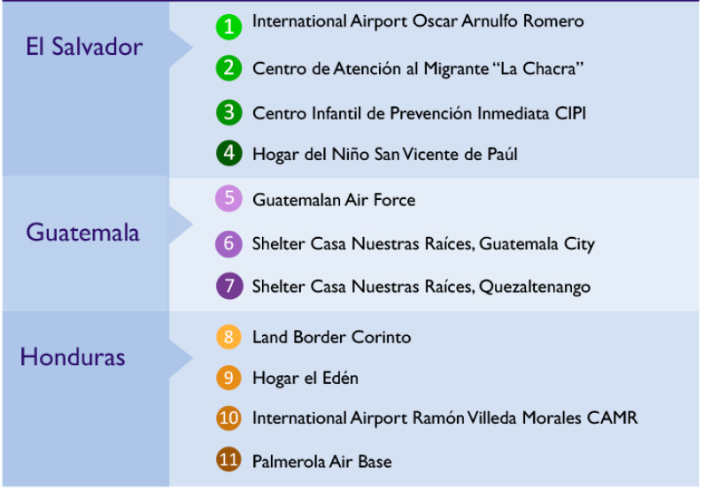
Intervention Sites by Country

Slide 5
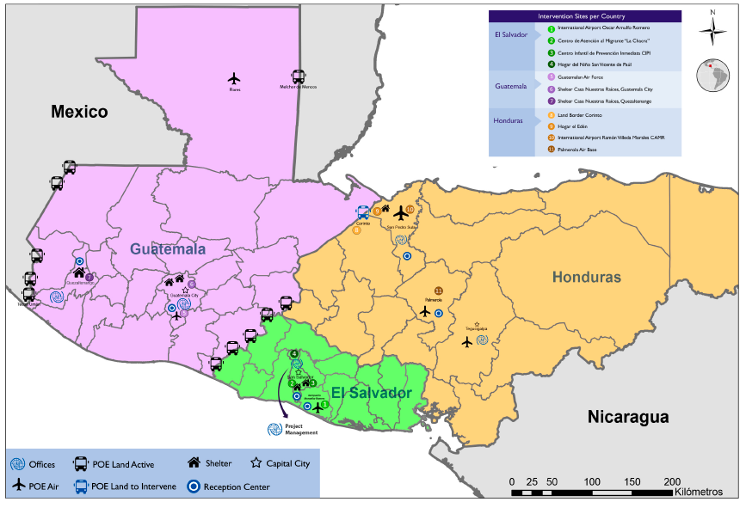
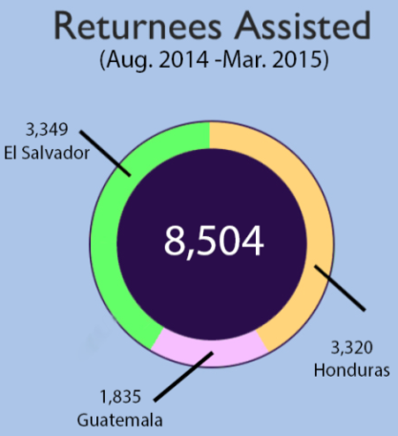
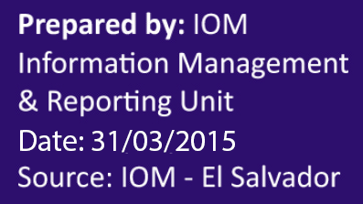
Locations and Activities

Slide 6
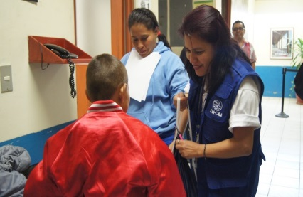
Achievements
7,740 returned persons (unaccompanied boys, girls and adolescents, families and adults) have received direct assistance.
11 infrastructure projects are being implemented to improve the capacity and management of reception processes at points of entry, reception centres and shelters.
271 government officials involved in reception processes and processing information about returned migrants have received training on human rights and migration, STIs/HIV and national legislation on the protection of boys, girls and adolescents, through implementation of 24 training workshops.
Action plans are in place to support the governments of the Northern Triangle countries in developing information campaigns to disseminate key messages on the risks of migration, the rights of migrants, etc., through comics, TV and radio programmes and others.
Technical support to improve data collection and transferral processes between institutions involved in the reception of returned persons, in order to improve the coordination between these institutions in regard to the services that they provide to returned migrants.
Hygiene Kit | Food | Transportation | Communication | Health care and psychosocial support | Accommodation
6,686 | 6,832 | 4,696 | 1,454 | 621 | 78

Slide 7
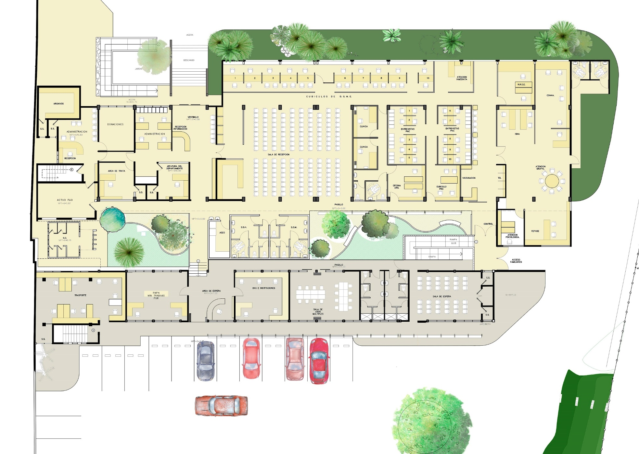
Migrant Assistance Centre, La Chacra, El Salvador

Slide 8
Reception Mechanisms by Area
El Salvador
Adults
Honduras
Adults
Guatemala
Adults and families
Boys, girls and adolescents
Boys, girls, adolescents and families
Boys, girls, adolescents and families
Immigration
Control
Reception centre
Registration and interview
Medical examination
Police interview
Protection of b./g./a., family links
Transportation
Family reunification
Temporary shelter

Slide 9
Reception Mechanisms by Land
El Salvador
Adults
Honduras
Adults
Guatemala
Adults and families
Boys, girls and adolescents
Boys, girls, adolescents and families
Boys, girls, adolescents and families
Immigration
Control
Reception centre
Registration and interview
Medical examination
Police interview
Protection of b./g./a., family links
Transportation
Family reunification
Temporary shelter

Slide 10
Information Management Unit
STATISTICS
Statistics units will be strengthened in various immigration institutions in the Northern Triangle countries. This will be achieved through improving data recording systems at the points of entry of the returned persons.
CHALLENGES
Various methodologies for information management and dissemination (collecting, reports, mapping, etc.)
Standards for information service management.
Types of systems and equipment used to ensure an efficient and effective production of statistics.

Slide 11
Information Management Unit
RESULTS
High-quality and timely information available and shared between agencies, using tools and instruments specifically developed for this process.
Presenting results is possible through the strategic strengthening of human resources and information sharing methodologies.
DATA INTEGRATION
IOM El Salvador. An only data collection form for all institutions.
IOM Guatemala. An only data collection form for unaccompanied boys, girls and adolescents.
IOM Honduras. Support to purchase equipment for CENNIS and INM.

Slide 12
Programmatic Challenges
Reintegration/human capital development: The installed capacity for sustainable reintegration is limited.
Information management and data processing: A high demand for information about return processes, large amounts of data, inconsistencies and asymmetries in data processing and exchange. Very basic technology and tools for data processing and storage.
Consolidating and promoting coordination and national and regional efforts. Collaboration between agencies/government.
A diversity of humanitarian actors at different stages; given the multiplicity of actors, strengthening is required to prevent duplication of efforts and maximise resources.
Implementing actions at a community level in communities with a high incidence of migration.
Seeking to achieve sustainability in all our actions.

Slide 13
THANK YOU
Cleo Hennessy
Sub regional Project Manager
chennessy@iom.int

