Slide 1
OPORTUNIDADES Y LIMITACIONES DE LA ACCIÓN EJECUTIVA: ¿CUÁNTOS MEXICANOS Y CENTROAMERICANOS PUEDEN BENEFICIARSE?
Marc Rosenblum,
Director Adjunto, Política de Inmigración de los Estados Unidos
14 de abril de 2015

Slide 2
De gran importancia para México y los países del triángulo norte de Centroamérica
Porcentajes de la población total de los EEUU de personas nacidas en el extranjero, por país de origen, 2013
Fuente: Cálculos del Migration Policy Institute (MPI) del censo de los EEUU, encuesta titulada “American Community Survey”.
3

Slide 3
De gran importancia para México y los países del triángulo norte de Centroamérica
Porcentajes de población no autorizada en los Estados Unidos, por país de origen, 2013
Fuente: Análisis del MPI de los datos de SIPP para 2008 y de ACP para 2009-2013 de Van Hook, Bachmeier y Hammar.
4

Slide 4
De gran importancia para México y los países del triángulo norte de Centroamérica
Porcentajes de poblaciones que cumplen los requisitos para optar a DACA, por país de origen, 2013
Fuente: Análisis del MPI de los datos de SIPP para 2008 y de ACS para 2009-2013 de Van Hook, Bachmeier y Hammar.
5

Slide 5
De gran importancia para México y los países del triángulo norte de Centroamérica
Porcentajes de poblaciones que cumplen los requisitos para optar a DAPA, por país de origen, 2013
Fuente: Análisis del MPI de los datos de SIPP para 2008 y de ACS para 2009-2013 de Van Hook, Bachmeier y Hammar.
6

Slide 6
Estimación de poblaciones que cumplen los requisitos para optar a DAPA/DACA, por país de origen, 2013
País o región | Cumplen los requisitos para la Acción Diferida para Padres de Estadounidenses (DAPA) | Cumplen los requisitos para la Acción Diferida para los Llegados en la Infancia (DACA) | Total de personas que cumplen los requisitos para la Acción Diferida | Total de población no autorizada | Acción Diferida como % de no autorizados
Total | 3,605,000 | 1,439,000 | 5,045,000 | 11,022,000 | 46
México | 2,415,000 | 861,000 | 3,276,000 | 6,194,000 | 53
Centroamérica
Guatemala | 213,000 | 59,000 | 273,000 | 704,000 | 39
El Salvador | 92,000 | 36,000 | 128,000 | 436,000 | 29
Honduras | 68,000 | 25,000 | 94,000 | 317,000 | 30
Otros países de C.A. | 35,000 | 23,000 | 58,000 | 146,000 | 40
Asia | 358,000 | 191,000 | 548,000 | 1,509,000 | 36
Sudamérica | 183,000 | 102,000 | 284,000 | 690,000 | 41
Europa/Canadá/Oceanía | 93,000 | 60,000 | 153,000 | 423,000 | 36
África | 80,000 | 42,000 | 122,000 | 342,000 | 36
Caribe | 69,000 | 39,000 | 108,000 | 260,000 | 42
Fuente: Análisis del Migration Policy Institute (MPI) de datos de la encuesta titulada “Survey of Income and Program Participation” (SIPP) para 2008 y la encuesta “American Community Survey” (ACS) 2009-2013, compilados por Jennifer Van Hook de la Pennsylvania State University y James Bachmeier y Colin Hammar de la Temple University.
2

Slide 7
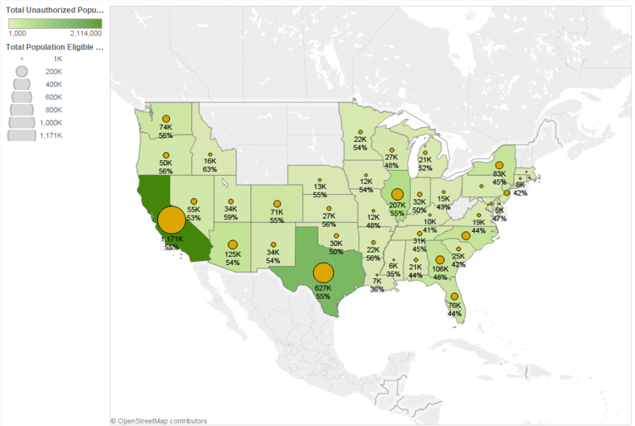
Ciudadanos mexicanos que cumplen los requisitos para optar a DAPA/DACA: 2013
Fuente: Análisis del MPI de los datos de SIPP para 2008 y de ACS para 2009-2013 de Van Hook, Bachmeier y Hammar.
7

Slide 8
Ciudadanos mexicanos que cumplen los requisitos para optar a DAPA/DACA: 2013
Estado | Cumplen los requisitos para DAPA | Cumplen los requisitos para DACA | Total de personas que cumplen los requisitos para la Acción Diferida | Total de no autorizados | Acción Diferida como % de no autorizados
California | 851,000 | 320,000 | 1,171,000 | 2,114,000 | 55
Texas | 471,000 | 156,000 | 627,000 | 1,138,000 | 55
Illinois | 148,000 | 59,000 | 207,000 | 373,000 | 55
Arizona | 88,000 | 36,000 | 125,000 | 229,000 | 54
Georgia | 79,000 | 27,000 | 106,000 | 220,000 | 48
North Carolina | 78,000 | 24,000 | 102,000 | 211,000 | 48
New York | 63,000 | 20,000 | 83,000 | 186,000 | 45
Florida | 56,000 | 20,000 | 76,000 | 171,000 | 44
Washington | 57,000 | 18,000 | 74,000 | 133,000 | 56
Colorado | 54,000 | 18,000 | 71,000 | 129,000 | 55
New Jersey | 33,000 | 12,000 | 45,000 | 109,000 | 41
Nevada | 40,000 | 14,000 | 55,000 | 102,000 | 53
Oregon | 38,000 | 12,000 | 50,000 | 89,000 | 56
Tennessee | 23,000 | 8,000 | 31,000 | 68,000 | 45
Indiana | 24,000 | 8,000 | 32,000 | 64,000 | 50
New Mexico | 24,000 | 10,000 | 34,000 | 62,000 | 54
Oklahoma | 22,000 | 8,000 | 30,000 | 60,000 | 50
South Carolina | 20,000 | 5,000 | 25,000 | 59,000 | 42
Utah | 26,000 | 8,000 | 34,000 | 58,000 | 59
Wisconsin | 19,000 | 8,000 | 27,000 | 57,000 | 48
Kansas | 20,000 | 7,000 | 27,000 | 48,000 | 56
Alabama | 16,000 | 5,000 | 21,000 | 46,000 | 44
Virginia | 13,000 | 5,000 | 19,000 | 42,000 | 44
Minnesota | 16,000 | 5,000 | 22,000 | 40,000 | 54
Michigan | 16,000 | 5,000 | 21,000 | 40,000 | 52
Fuente: Análisis del MPI de los datos de SIPP para 2008 y de ACS para 2009-2013 de Van Hook, Bachmeier y Hammar.
8

Slide 9
Ciudadanos mexicanos que cumplen los requisitos para optar a DAPA/DACA: 2013
Condado | Cumplen los requisitos para DAPA | Cumplen los requisitos para DACA | Total de personas que cumplen los requisitos para la Acción Diferida | Total de no autorizados | Acción Diferida como % de no autorizados
Los Angeles County, California | 262,000 | 95,000 | 357,000 | 647,000 | 55
Harris County, Texas | 101,000 | 34,000 | 135,000 | 241,000 | 56
Cook County, Illinois | 88,000 | 36,000 | 125,000 | 226,000 | 55
Orange County, California | 79,000 | 32,000 | 112,000 | 203,000 | 55
Dallas County, Texas | 81,000 | 24,000 | 105,000 | 191,000 | 55
Maricopa County, Arizona | 65,000 | 26,000 | 91,000 | 163,000 | 56
San Diego County, California | 62,000 | 26,000 | 88,000 | 158,000 | 56
Riverside County, California | 57,000 | 21,000 | 78,000 | 128,000 | 60
San Bernardino County, California | 48,000 | 18,000 | 66,000 | 110,000 | 60
Hidalgo County, Texas | 39,000 | 14,000 | 53,000 | 92,000 | 58
Tarrant County, Texas | 36,000 | 10,000 | 45,000 | 84,000 | 54
Santa Clara County, California | 31,000 | 12,000 | 43,000 | 82,000 | 52
Clark County, Nevada | 31,000 | 11,000 | 42,000 | 82,000 | 51
Fresno County, California | 31,000 | 11,000 | 42,000 | 75,000 | 56
Kern County, California | 27,000 | 9,000 | 36,000 | 64,000 | 57
Monterey-San Benito , California | 24,000 | 9,000 | 33,000 | 62,000 | 53
El Paso County, Texas | 22,000 | 8,000 | 30,000 | 57,000 | 53
Travis County, Texas | 23,000 | 8,000 | 30,000 | 60,000 | 50
Bexar County, Texas | 20,000 | 9,000 | 30,000 | 57,000 | 52
Alameda County, California | 21,000 | 8,000 | 29,000 | 57,000 | 51
Tulare County, California | 21,000 | 7,000 | 28,000 | 47,000 | 59
Ventura County, California | 21,000 | 7,000 | 27,000 | 53,000 | 51
Suburban Denver, Colorado | 19,000 | 6,000 | 25,000 | 44,000 | 56
San Joaquin County, California | 17,000 | 7,000 | 24,000 | 43,000 | 56
Contra Costa County, California | 16,000 | 5,000 | 21,000 | 39,000 | 55
Fuente: Análisis del MPI de los datos de SIPP para 2008 y de ACS para 2009-2013 de Van Hook, Bachmeier y Hammar.
9

Slide 10
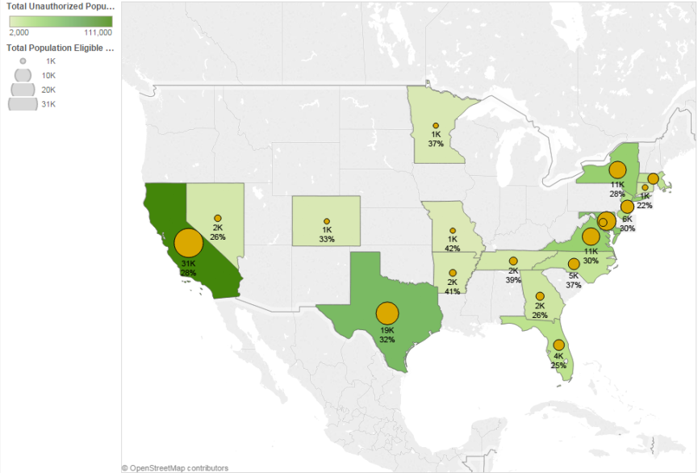
Ciudadanos salvadoreños que cumplen los requisitos para optar a DAPA/DACA: 2013
Fuente: Análisis del MPI de los datos de SIPP para 2008 y de ACS para 2009-2013 de Van Hook, Bachmeier y Hammar.
10

Slide 11
Ciudadanos salvadoreños que cumplen los requisitos para optar a DAPA/DACA: 2013
Estado | Cumplen los requisitos para DAPA | Cumplen los requisitos para DACA | Total de personas que cumplen los requisitos para la Acción Diferida | Total de no autorizados | Acción Diferida como % de no autorizados
California | 21,000 | 9,000 | 31,000 | 111,000 | 28
Texas | 14,000 | 5,000 | 19,000 | 60,000 | 32
Maryland | 10,000 | 3,000 | 13,000 | 47,000 | 28
New York | 7,000 | 4,000 | 11,000 | 39,000 | 28
Virginia | 8,000 | 3,000 | 11,000 | 37,000 | 30
New Jersey | 5,000 | 2,000 | 6,000 | 21,000 | 30
Florida | 3,000 | 1,000 | 4,000 | 17,000 | 25
Massachusetts | 3,000 | 2,000 | 4,000 | 15,000 | 29
North Carolina | 4,000 | 1,000 | 5,000 | 13,000 | 37
Georgia | 2,000 | <1,000 | 2,000 | 9,000 | 26
DC | 2,000 | <1,000 | 2,000 | 7,000 | 35
Nevada | 1,000 | <1,000 | 2,000 | 6,000 | 26
Tennessee | 2,000 | <1,000 | 2,000 | 6,000 | 39
Connecticut | <1,000 | <1,000 | 1,000 | 6,000 | 22
Arkansas | 1,000 | <1,000 | 2,000 | 4,000 | 41
Colorado | <1,000 | <1,000 | 1,000 | 3,000 | 33
Washington | <1,000 | <1,000 | <1,000 | 3,000 | 22
Pennsylvania | <1,000 | <1,000 | <1,000 | 3,000 | 32
Minnesota | <1,000 | <1,000 | 1,000 | 3,000 | 37
Ohio | <1,000 | <1,000 | <1,000 | 2,000 | 24
Missouri | <1,000 | <1,000 | 1,000 | 2,000 | 42
Louisiana | <1,000 | <1,000 | <1,000 | 2,000 | 27
Arizona | <1,000 | <1,000 | <1,000 | 2,000 | 20
Nebraska | <1,000 | <1,000 | <1,000 | 2,000 | 27
Illinois | <1,000 | <1,000 | <1,000 | 2,000 | 23
Fuente: Análisis del MPI de los datos de SIPP para 2008 y de ACS para 2009-2013 de Van Hook, Bachmeier y Hammar.
11

Slide 12
Ciudadanos salvadoreños que cumplen los requisitos para optar a DAPA/DACA: 2013
Condado | Cumplen los requisitos para DAPA | Cumplen los requisitos para DACA | Total de personas que cumplen los requisitos para la Acción Diferida | Total de no autorizados | Acción Diferida como % de no autorizados
Los Angeles County, California | 12,000 | 5,000 | 17,000 | 63,000 | 27
Harris County, Texas | 8,000 | 2,000 | 10,000 | 31,000 | 33
Montgomery County, Maryland | 4,000 | 1,000 | 5,000 | 20,000 | 27
Prince George's County, Maryland | 4,000 | 1,000 | 5,000 | 17,000 | 28
Boston Area NECTA**, Massachusetts | 2,000 | 1,000 | 4,000 | 14,000 | 28
Fairfax County, Virginia | 3,000 | <1,000 | 4,000 | 13,000 | 29
Dallas County, Texas | 3,000 | <1,000 | 4,000 | 13,000 | 31
Nassau County, New York | 2,000 | <1,000 | 3,000 | 13,000 | 24
Suffolk County, New York | 2,000 | 2,000 | 4,000 | 12,000 | 33
Prince William County, Virginia | 2,000 | <1,000 | 3,000 | 8,000 | 35
Union County, New Jersey | 1,000 | <1,000 | 2,000 | 7,000 | 29
Hudson County, New Jersey | 2,000 | <1,000 | 2,000 | 6,000 | 35
Orange County, California | 1,000 | <1,000 | 2,000 | 6,000 | 28
Clark County, Nevada | 1,000 | <1,000 | 1,000 | 6,000 | 27
Queens County, New York | 1,000 | <1,000 | 2,000 | 5,000 | 32
Alameda County, California | 1,000 | <1,000 | 2,000 | 5,000 | 32
Miami-Dade-Monroe Counties, Florida | <1,000 | <1,000 | 1,000 | 5,000 | 21
San Mateo County, California | <1,000 | <1,000 | 1,000 | 4,000 | 31
Gwinnett County, Georgia | <1,000 | <1,000 | 1,000 | 4,000 | 33
Mecklenburg County, North Carolina | 1,000 | <1,000 | 1,000 | 4,000 | 32
San Bernardino County, California | <1,000 | <1,000 | 1,000 | 4,000 | 26
Contra Costa County, California | <1,000 | <1,000 | <1,000 | 4,000 | 25
Baltimore County, Maryland | <1,000 | <1,000 | 1,000 | 4,000 | 28
Riverside County, California | <1,000 | <1,000 | 1,000 | 3,000 | 38
Santa Clara County, California | <1,000 | <1,000 | <1,000 | 3,000 | 18
Fuente: Análisis del MPI de los datos de SIPP para 2008 y de ACS para 2009-2013 de Van Hook, Bachmeier y Hammar. .
12

Slide 13
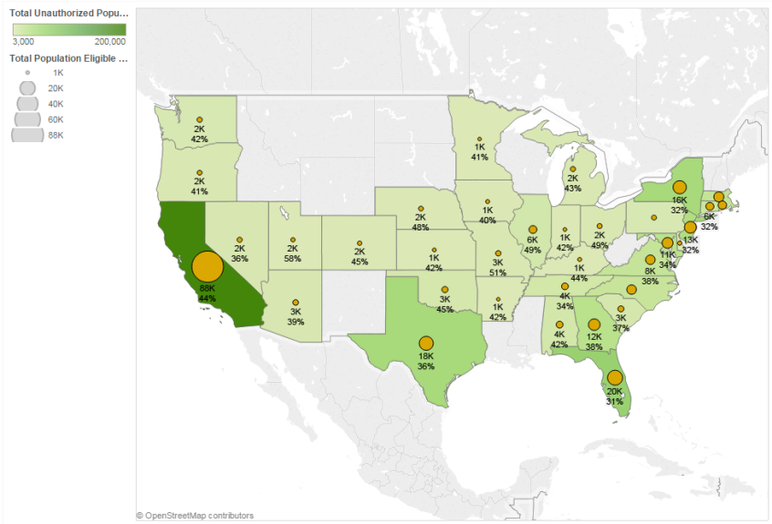
Ciudadanos guatemaltecos que cumplen los requisitos para optar a DAPA/DACA: 2013
Fuente: Análisis del MPI de los datos de SIPP para 2008 y de ACS para 2009-2013 de Van Hook, Bachmeier y Hammar.
13

Slide 14
Ciudadanos guatemaltecos que cumplen los requisitos para optar a DAPA/DACA: 2013
Estado | Cumplen los requisitos para DAPA | Cumplen los requisitos para DACA | Total de personas que cumplen los requisitos para la Acción Diferida | Total de no autorizados | Acción Diferida como % de no autorizados
California | 69,000 | 20,000 | 88,000 | 200,000 | 44
Florida | 15,000 | 5,000 | 20,000 | 66,000 | 31
New York | 12,000 | 4,000 | 16,000 | 50,000 | 32
Texas | 14,000 | 4,000 | 18,000 | 49,000 | 36
New Jersey | 10,000 | 3,000 | 13,000 | 39,000 | 32
Georgia | 10,000 | 2,000 | 12,000 | 32,000 | 38
Maryland | 9,000 | 2,000 | 11,000 | 31,000 | 34
Massachusetts | 7,000 | 2,000 | 9,000 | 23,000 | 40
Virginia | 7,000 | 2,000 | 8,000 | 22,000 | 38
North Carolina | 7,000 | 1,000 | 8,000 | 21,000 | 39
Connecticut | 4,000 | 1,000 | 6,000 | 18,000 | 32
Rhode Island | 5,000 | 2,000 | 6,000 | 14,000 | 44
Tennessee | 4,000 | <1,000 | 4,000 | 12,000 | 34
Illinois | 4,000 | 2,000 | 6,000 | 11,000 | 49
Alabama | 3,000 | <1,000 | 4,000 | 10,000 | 42
South Carolina | 3,000 | <1,000 | 3,000 | 9,000 | 37
Oklahoma | 3,000 | <1,000 | 3,000 | 8,000 | 45
Arizona | 2,000 | <1,000 | 3,000 | 7,000 | 39
Nevada | 2,000 | <1,000 | 2,000 | 7,000 | 36
Pennsylvania | 2,000 | <1,000 | 2,000 | 6,000 | 35
Washington | 2,000 | <1,000 | 2,000 | 6,000 | 42
Michigan | 2,000 | <1,000 | 2,000 | 5,000 | 43
Oregon | 2,000 | <1,000 | 2,000 | 5,000 | 41
Missouri | 2,000 | <1,000 | 3,000 | 5,000 | 51
Ohio | 2,000 | <1,000 | 2,000 | 5,000 | 49
Fuente: Análisis del MPI de los datos de SIPP para 2008 y de ACS para 2009-2013 de Van Hook, Bachmeier y Hammar.
14

Slide 15
Ciudadanos guatemaltecos que cumplen los requisitos para optar a DAPA/DACA: 2013
Condado | Cumplen los requisitos para DAPA | Cumplen los requisitos para DACA | Total de personas que cumplen los requisitos para la Acción Diferida | Total de no autorizados | Acción Diferida como % de no autorizados
Los Angeles County, California | 45,000 | 12,000 | 58,000 | 133,000 | 43
Harris County, Texas | 7,000 | 2,000 | 9,000 | 23,000 | 40
Palm Beach County, Florida | 5,000 | 2,000 | 6,000 | 22,000 | 30
Boston Area NECTA**, Massachusetts | 6,000 | 2,000 | 7,000 | 20,000 | 38
Prince George's County, Maryland | 3,000 | <1,000 | 4,000 | 16,000 | 27
Miami-Dade-Monroe, Florida | 3,000 | <1,000 | 4,000 | 14,000 | 30
Fairfield County, Connecticut | 3,000 | 1,000 | 5,000 | 14,000 | 33
Providence County, Rhode Island | 5,000 | 2,000 | 6,000 | 14,000 | 44
Westchester County, New York | 2,000 | <1,000 | 3,000 | 10,000 | 35
Orange County, California | 3,000 | <1,000 | 4,000 | 10,000 | 45
Mercer County, New Jersey | 3,000 | <1,000 | 3,000 | 9,000 | 38
Cook County, Illinois | 3,000 | 1,000 | 4,000 | 8,000 | 49
Montgomery County, Maryland | 3,000 | <1,000 | 3,000 | 8,000 | 42
Riverside County, California | 3,000 | <1,000 | 4,000 | 8,000 | 49
Kings County, New York | <1,000 | <1,000 | 1,000 | 8,000 | 15
Union County, New Jersey | 2,000 | <1,000 | 2,000 | 7,000 | 25
Lee County, Florida | 2,000 | <1,000 | 2,000 | 7,000 | 29
Dallas County, Texas | 2,000 | <1,000 | 2,000 | 7,000 | 30
Queens County, New York | 2,000 | <1,000 | 3,000 | 7,000 | 36
Hudson County, New Jersey | 1,000 | <1,000 | 2,000 | 7,000 | 26
Suffolk County, New York | 2,000 | <1,000 | 2,000 | 7,000 | 29
DeKalb County, Georgia | <1,000 | <1,000 | 1,000 | 7,000 | 16
San Bernardino County, California | 3,000 | <1,000 | 3,000 | 6,000 | 54
Maricopa County, Arizona | 2,000 | <1,000 | 3,000 | 6,000 | 42
Fairfax County, Virginia | 2,000 | <1,000 | 2,000 | 6,000 | 37
Fuente: Análisis del MPI de los datos de SIPP para 2008 y de ACS para 2009-2013 de Van Hook, Bachmeier y Hammar.
15

Slide 16
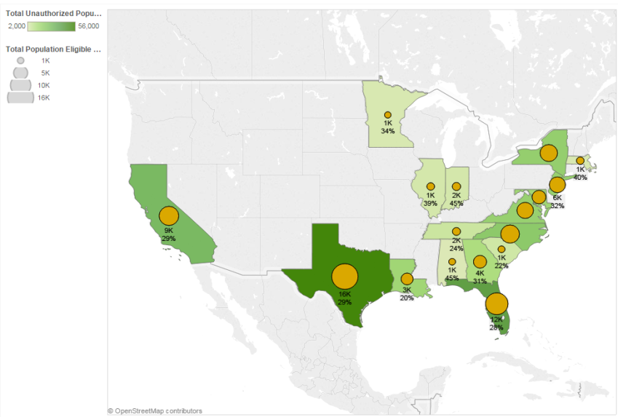
Ciudadanos hondureños que cumplen los requisitos para optar a DAPA/DACA: 2013
Fuente: Análisis del MPI de los datos de SIPP para 2008 y de ACS para 2009-2013 de Van Hook, Bachmeier y Hammar.
16

Slide 17
Ciudadanos hondureños que cumplen los requisitos para optar a DAPA/DACA: 2013
Estado | Cumplen los requisitos para DAPA | Cumplen los requisitos para DACA | Total de personas que cumplen los requisitos para la Acción Diferida | Total de no autorizados | Acción Diferida como % de no autorizados
Texas | 13,000 | 4,000 | 16,000 | 56,000 | 29
Florida | 8,000 | 3,000 | 12,000 | 43,000 | 28
California | 6,000 | 3,000 | 9,000 | 31,000 | 29
North Carolina | 7,000 | 2,000 | 8,000 | 24,000 | 35
New York | 5,000 | 2,000 | 7,000 | 21,000 | 34
Virginia | 5,000 | 2,000 | 6,000 | 20,000 | 32
New Jersey | 4,000 | 3,000 | 6,000 | 20,000 | 32
Louisiana | 3,000 | <1,000 | 3,000 | 17,000 | 20
Maryland | 3,000 | 1,000 | 5,000 | 17,000 | 27
Georgia | 3,000 | 1,000 | 4,000 | 13,000 | 31
Tennessee | 1,000 | <1,000 | 2,000 | 6,000 | 24
South Carolina | <1,000 | <1,000 | 1,000 | 5,000 | 22
Indiana | 1,000 | <1,000 | 2,000 | 4,000 | 45
Illinois | <1,000 | <1,000 | 1,000 | 4,000 | 39
Massachusetts | <1,000 | <1,000 | 1,000 | 3,000 | 40
Minnesota | <1,000 | <1,000 | 1,000 | 3,000 | 34
Pennsylvania | <1,000 | <1,000 | <1,000 | 3,000 | 32
Colorado | <1,000 | <1,000 | <1,000 | 2,000 | 33
Alabama | <1,000 | <1,000 | 1,000 | 2,000 | 45
Oklahoma | <1,000 | <1,000 | <1,000 | 2,000 | 33
Connecticut | <1,000 | <1,000 | <1,000 | 2,000 | 27
Arkansas | <1,000 | <1,000 | <1,000 | 2,000 | 18
Kansas | <1,000 | <1,000 | <1,000 | 2,000 | 31
Washington | <1,000 | <1,000 | <1,000 | 1,000 | 24
Ohio | <1,000 | <1,000 | <1,000 | 1,000 | 21
Fuente: Análisis del MPI de los datos de SIPP para 2008 y de ACS para 2009-2013 de Van Hook, Bachmeier y Hammar.
17

Slide 18
Ciudadanos hondureños que cumplen los requisitos para optar a DAPA/DACA: 2013
Condado | Cumplen los requisitos para DAPA | Cumplen los requisitos para DACA | Total de personas que cumplen los requisitos para la Acción Diferida | Total de no autorizados | Acción Diferida como % de no autorizados
Harris County, Texas | 7,000 | 2,000 | 9,000 | 29,000 | 31
Miami-Dade-Monroe Counties, Florida | 4,000 | 2,000 | 6,000 | 20,000 | 30
Los Angeles County, California | 3,000 | 2,000 | 5,000 | 16,000 | 31
Dallas County, Texas | 2,000 | <1,000 | 3,000 | 8,000 | 32
Mecklenburg County, North Carolina | 2,000 | <1,000 | 2,000 | 7,000 | 33
Fairfax County, Virginia | 2,000 | <1,000 | 2,000 | 7,000 | 28
Montgomery County, Maryland | <1,000 | <1,000 | 1,000 | 7,000 | 22
Broward County, Florida | <1,000 | <1,000 | 1,000 | 6,000 | 17
Travis County, Texas | 1,000 | <1,000 | 1,000 | 5,000 | 23
Bronx County, New York | 1,000 | <1,000 | 2,000 | 5,000 | 34
Nassau County, New York | 1,000 | <1,000 | 2,000 | 5,000 | 37
Prince George's County, Maryland | <1,000 | <1,000 | <1,000 | 4,000 | 21
Palm Beach County, Florida | <1,000 | <1,000 | <1,000 | 4,000 | 16
Hudson County, New Jersey | <1,000 | <1,000 | 1,000 | 4,000 | 35
Gwinnett County, Georgia | <1,000 | <1,000 | 1,000 | 3,000 | 34
Suffolk County, New York | <1,000 | <1,000 | <1,000 | 3,000 | 30
Essex County, New Jersey | <1,000 | <1,000 | <1,000 | 3,000 | 21
Boston Area NECTA**, Massachusetts | <1,000 | <1,000 | 1,000 | 3,000 | 35
Hillsborough County, Florida | <1,000 | <1,000 | <1,000 | 3,000 | 32
Kings County, New York | <1,000 | <1,000 | <1,000 | 3,000 | 34
Queens County, New York | <1,000 | <1,000 | <1,000 | 3,000 | 24
Baltimore County, Maryland | <1,000 | <1,000 | 1,000 | 3,000 | 57
DeKalb County, Georgia | <1,000 | <1,000 | <1,000 | 3,000 | 24
Middlesex County, New Jersey | <1,000 | <1,000 | <1,000 | 2,000 | 30
Tarrant County, Texas | <1,000 | <1,000 | <1,000 | 2,000 | 27
Fuente: Análisis del MPI de los datos de SIPP para 2008 y de ACS para 2009-2013 de Van Hook, Bachmeier y Hammar.
18

Slide 19
De gran importancia para México y los países del triángulo norte de Centroamérica
Porcentaje de todas las deportaciones formales desde los Estados Unidos, por país de origen 2003-2013
Fuente: Marc R. Rosenblum y Kristen McCabe, Deportation and Discretion: Reviewing the Record and Options for Change. Washington, DC: Migration Policy Institute, 2014.
19

Slide 20
De gran importancia para México y los países del triángulo norte de Centroamérica
Porcentajes de remociones internas desde el interior de los EEUU, por país de origen, 2003-2013
Fuente: Marc R. Rosenblum y Kristen McCabe, Deportation and Discretion: Reviewing the Record and Options for Change. Washington, DC: Migration Policy Institute, 2014.
20

Slide 21
Para obtener más información:
Marc Rosenblum
mrosenblum@migrationpolicy.org
T: (202) 266-1919 F: (202) 266-1940
www.migrationpolicy.org
21

