Slide 1
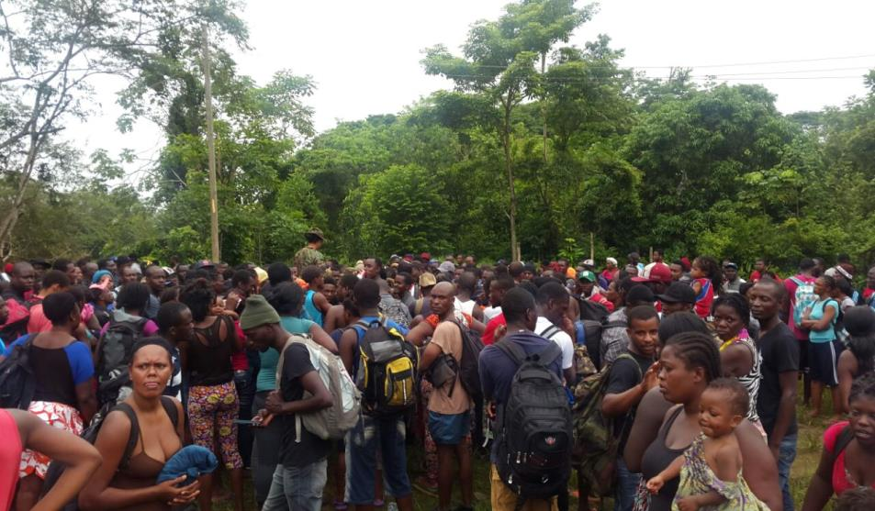
REPUBLIC OF PANAMA
THE HEALTH OF EXTRAREGIONAL MIGRANTS: A COMPREHENSIVE APPROACH

Slide 2
Management of Irregular Migration Flows
Aimed at counteracting
Offer
Demand
Organized Crime
NETWORKS AND COYOTES
Cubans, Extracontinentals
Transport, guidance and shelter
Destination: USA
the actions of human trafficking networks

Slide 3
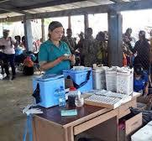
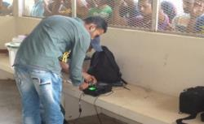
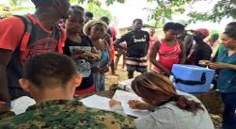
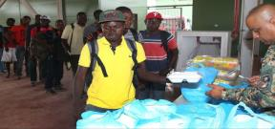
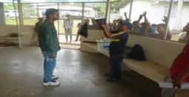
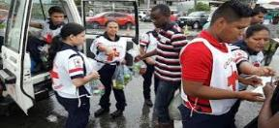
MANAGEMENT OF IRREGULAR MIGRATION FLOWS
Security
Biometric System
Humanitarian Aid
Rescues, food
Health
Primary health care
Salubridad
Atención medica primaria

Slide 4
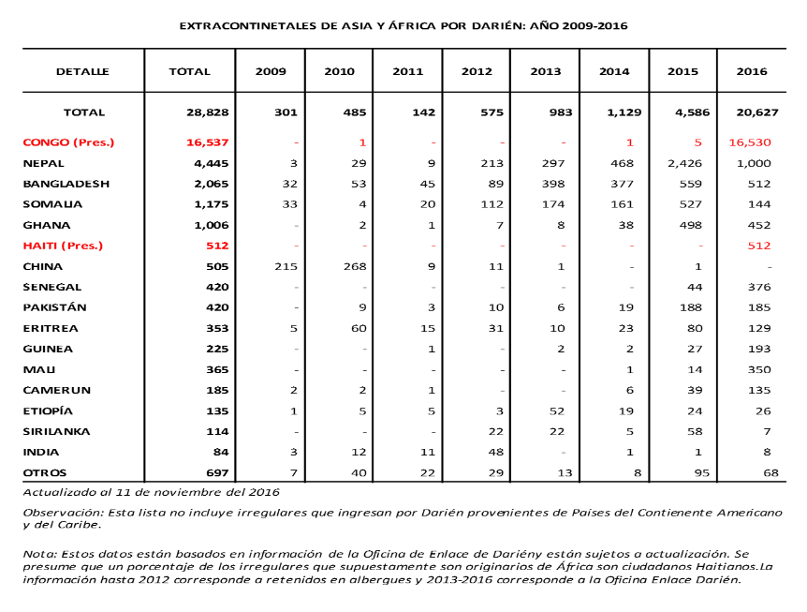
EXTRACONTINENTAL IRREGULAR MIGRANTS WHO ENTERED THE COUNTRY THROUGH THE DARIEN IN 2016

Slide 7
HUMANITARIAN AID
Food and shelter;
Essential hygienic services;
Health care;
Immunization (Yellow Fever, Influenza, MMR-MR);
Internal transfer to the border with Costa Rica.

Slide 8
Republic of Panama
Ministry of Health
Contingency Team
Subject: Health care for immigrants in temporary reception centres in the Province of Darién
Period: August 12-September 20, 2016
Department | Services | TOTAL | August | September^{P}
 |  |  | 7 days of services | 11 days of services^{P}
 |  |  | Total numbers, by month | Total numbers, by month
Medicine | Patients served | 4709 | 2063 | 2646
 | Transfers | 66 | 27 | 39
Infirmary | Subcutaneous medication | 1 | 0 | 1
 | Endovenous medication | 188 | 103 | 85
 | Intramuscular medication | 415 | 281 | 134
 | Intravenous infusion | 258 | 153 | 105
 | Taking blood pressure | 4121 | 1866 | 2255
 | Taking temperature | 427 | 177 | 250
 | Healing wounds | 204 | 149 | 55
Pharmacy | Patients served | 3884 | 1529 | 2355
 | Prescriptions provided | 3955 | 1898 | 2057
 | Prescription drugs delivered | 11115 | 4981 | 6134

Slide 9
Immunizations Conducted in 2016

Slide 10
Main Pathologies Identified in Extraregional Migrants (INMIR):
Minor trauma;
Dermatitis/piodermitis;
Diarrhea/dehydration;
Influenza-like syndrome.

Slide 11
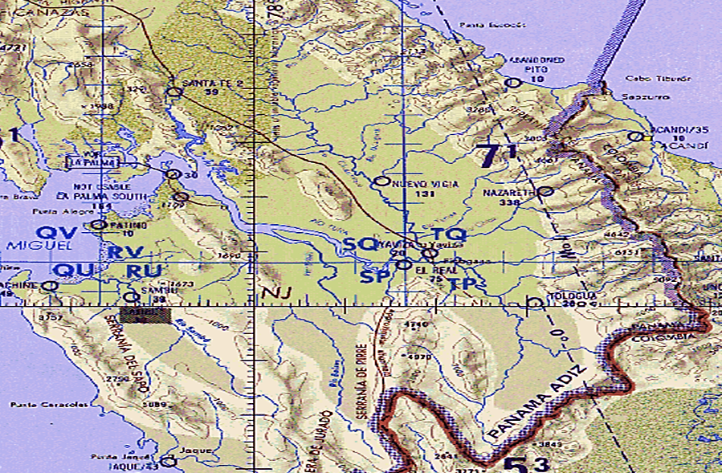
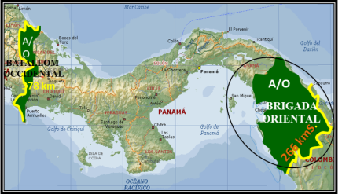
OPERATION “CONTROLLED MIGRATION FLOW”
OPERATIONAL APPROACH
PASO CANOAS
PANAMA CITY
ETAH
NICANOR
1,537
ETAH
MASHDI
344
reeee
ETAH LAJA BLANCA
-------
ETAH
PEÑITA
531
TOTAL NUMBER OF INMIR: 2,412
IN TRANSIT: APPROX. 1,491
EXIT TO PANAMA: 100
Lajas Blancas
Checkpoint
PC5
NUEVO VIGIA
637
ENTRADA
INMIR
PC4
MARRAGANTI
367
PC3
B. CHIQUITO
126
PC2
C. BLANCA
151 approx.
PC1
C. BLANCA
210 approx.

Slide 12
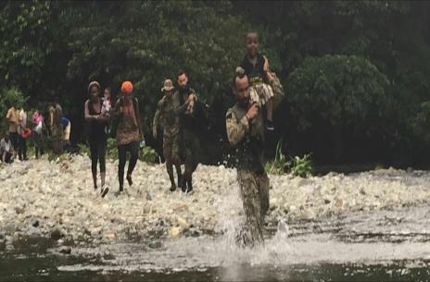
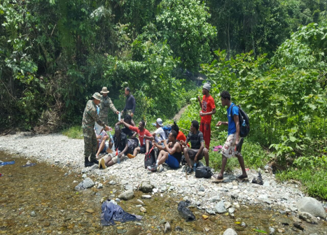
HUMANITARIAN AID

Slide 13
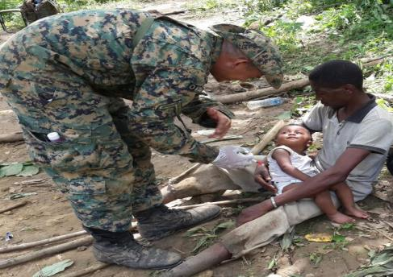
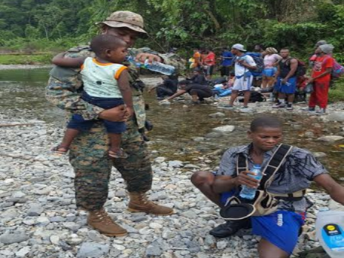
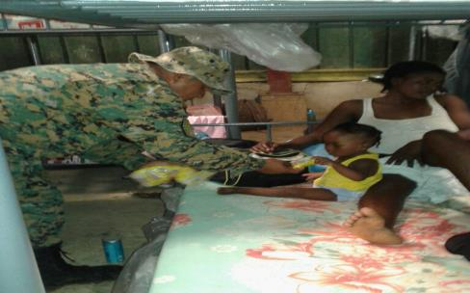
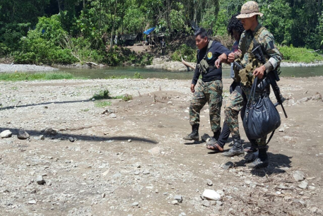
HUMANITARIAN AID

Slide 14
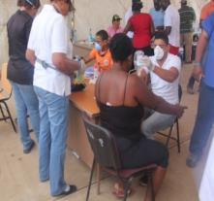
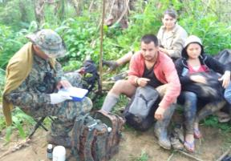
MEDICAL AND IMMUNIZATION DAY
YELLOW FEVER 3,332
MR (MEASLES, RUBELLA)
2,354
TOXOID
166
HEPATITIS A
895
INFLUENZA
3,805
MOST COMMON DISEASES
DIARRHEA
VOMITING
DERMATITIS
FUNGAL INFECTION ON THE FEET
DEHYDRATION
TOTAL
10,456
TOTAL NUMBER OF IMMUNIZATIONS DURING THE ACTIVITY

Slide 15
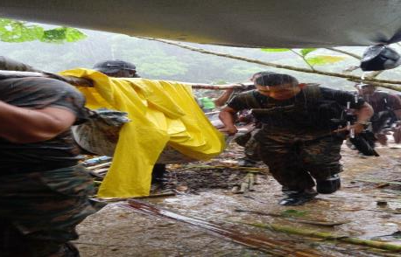
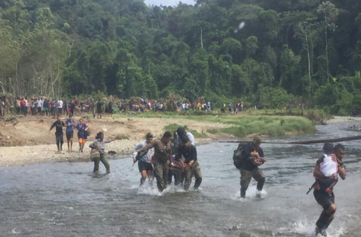
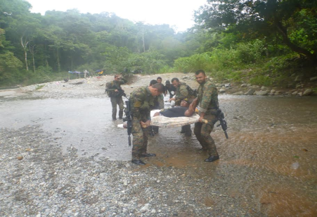
EVACUATIONS

Slide 16
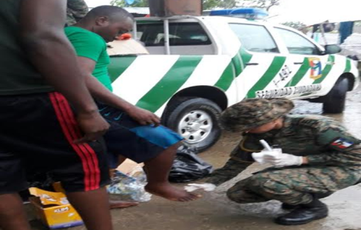
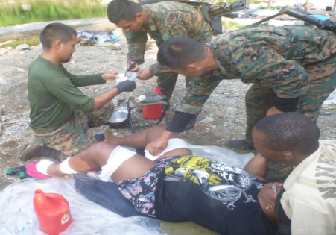
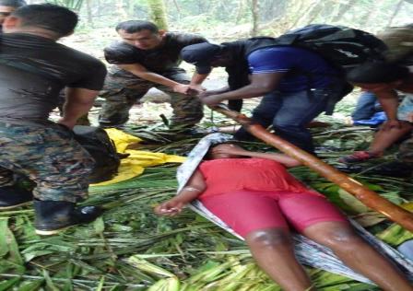
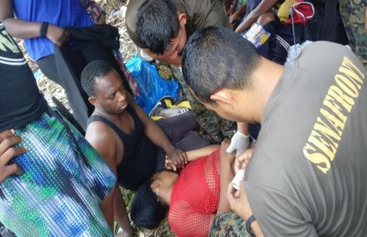
FIRST AID

Slide 17
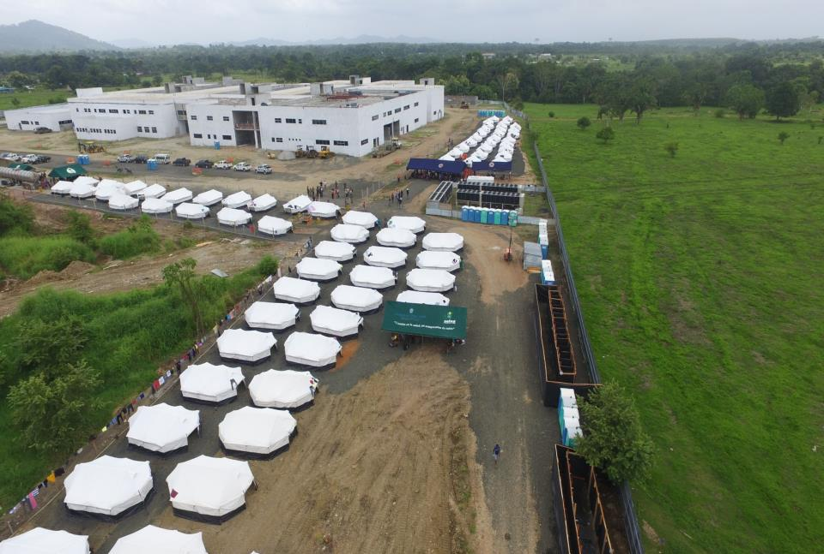
Temporary Humanitarian Assistance Station (ETAH)
Nicanor (Darien, Panama)

Slide 18
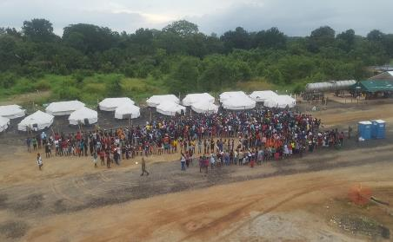
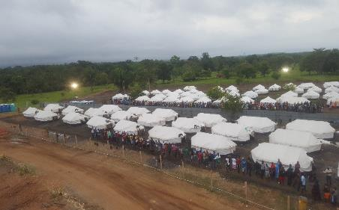
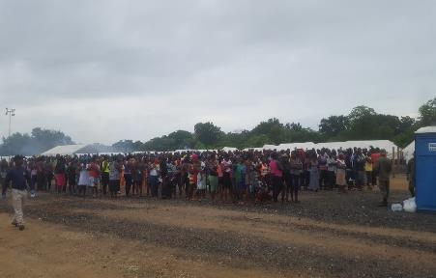
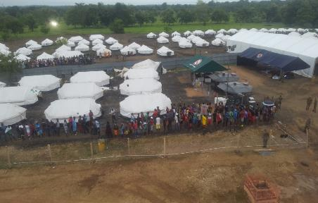
CONTROL ACTIONS
ETAH NICANOR
REORGANIZING THE DIFFERENT AREAS
DISTRIBUTION OF MIGRANTS
RECOUNT
CONTROLLING THE AREA

Slide 19
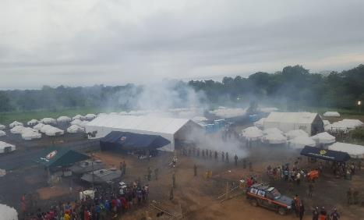
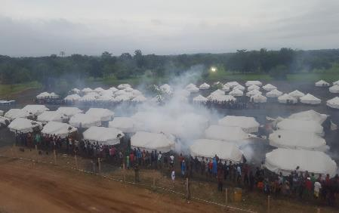
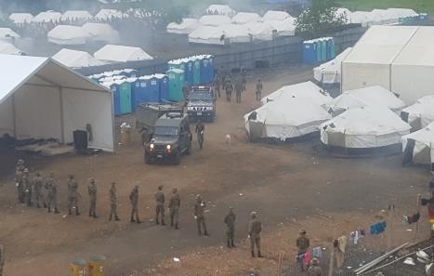
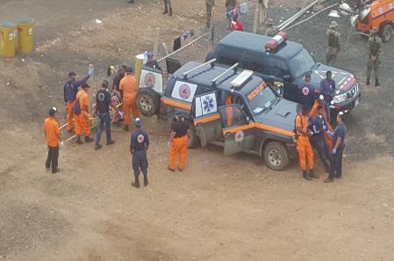
PREVENTION AND SUPPORT
ETAH NICANOR
SPRAYING OF THE AREA
SPRAYING OF TENTS
Controlling MIGRANT POPULATIONS
FRIENDLY FORCES SUPPORTING THE MISSION

Slide 20
FOR MIGRATION UNDER MORE HUMANE CONDITIONS – LET’S TAKE ACTION NOW

