Slide 1
Regional Conference on Migration (RCM) Work Plan of El Salvador as President Pro Tempore for the Term of Office of 2017 Liduvina Magarín Vice-Minister for Salvadorans Abroad November 2016

Slide 2
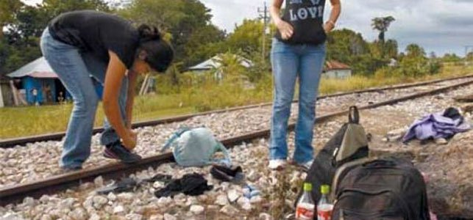
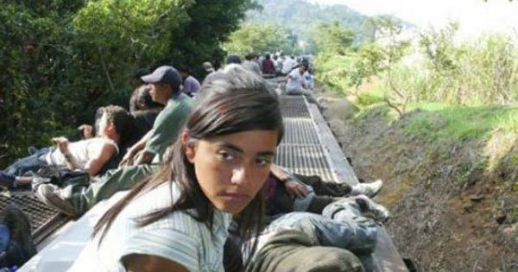
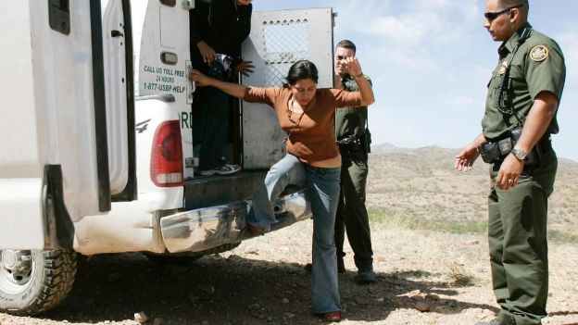
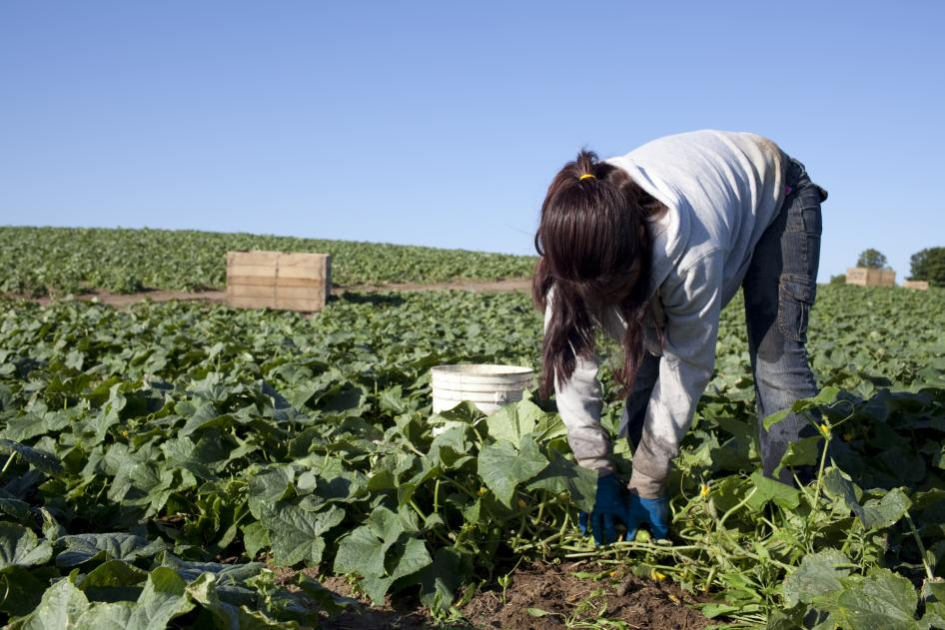
Central Theme: Migrant Women

Slide 3
According to the UNFPA Annual Report 2006, “today, women constitute almost half of all international migrants worldwide – 95 million”, that is, 49,6%. According to the World Migration Report 2011, 49% of the Salvadoran migrants were women; for Mexico, 46%; for Guatemala, 43%; for Honduras, 49%; for Nicaragua, 57%, etc.
The current context:

Slide 4
Female Migrants: Two Sides
Hardship
Separation from their children – many of them are single mothers;
Deep fissures in the social fabric in the country of origin;
Risk, abuse and human rights violations, differentiated from other population groups;
In the country of destination, they face challenges such as language and cultural barriers, limited job opportunities, etc.

Slide 5
Migrant Women: Two Sides
2. Hope
They can find better living conditions for themselves and their families;
They are agents for lasting change, since they have strong roots in their countries of origin and indissoluble links with their families and, in general, they always seek to ensure the well-being of their loved ones;
A leadership role, economically active in the country of origin and destination;
Agents for development, transforming their contexts.

Slide 6
The Vision of El Salvador as PPT
The RCM, with the objective of maintaining its position as a regional reference process, should make a qualitative leap to address the dynamics of the migration of women and its link to development in more depth, as well as specific protection for female migrants. Migrant women are distinguished by their needs – from the most basic and universal to the most specific.

Slide 7
General Objective:
To position the theme of Migrant Women at a regional level and thus, enable the implementation of initiatives to ensure full respect for the human rights of migrant women and to better harness the migration dynamics of this population group with the aim of fostering the development of their families, communities and countries of origin and destination.

Slide 8
Specific Objectives:
1.
To establish the theme of migrant women as a priority on the regional agenda, with full respect of the human rights of migrant women as the basis.
2.
To address the positive and negative impacts of migration of women in countries of origin, transit, destination and return, with a comprehensive, specific and inclusive approach.
3.
4.
To promote actions and programmes benefiting migrant women and the exchange of updated information and best practices in the region of the RCM through strengthening the links between relevant institutions, migration management spheres and civil society.
To create spaces for learning and reflection to enable citizens and civil servants from RCM Member Countries to gain a deep understanding of the link between women, migration and development.

Slide 9
Actions:
In addition to following up on the commitments made at the XXI Vice-Ministerial Meeting of the RCM, other actions have been considered that are in line with the objectives proposed by El Salvador as President pro tempore (PPT).

Slide 10
Actions:
1.
Promote a meeting of parlamenta-rians of RCM Member Countries
2.
Promote the adoption of a document on guidelines for action and the protection of migrant women
3.
4.
A diploma course on migrant women, together with academia
A course for consular officers on international regulations concerning migrant women

Slide 11
In Summary:
El Salvador is firmly committed to continue strengthening the work of the RCM during its term of office as President pro tempore. While only limited resources are available, we have no doubt that we will be supported by the other RCM Member Countries, organizations and civil society during the term of 2017.

Slide 12
Thank you

