Slide 1
Financial and activity report Technical Secretariat of the RCM
2015-2016

Slide 2
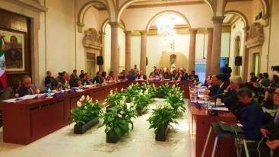
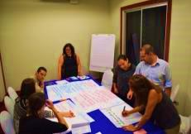
1.1 Activities
Vice-Ministerial Meeting, November 9th -12th
Meeting of the Troika, February 18th -19^{th,}
Workshop on Validation of documents relating to Children March 7th-12th
Follow-up on the Work of the Group on Migrant Childhood 10th -11th
RCGM Meeting June 7th -9th
Group on Extra-Continental Migration July 13th -14th , 2016)

Slide 3
Virtual Meeting Troika on Migrant Children
September 2nd
Workshop Migration & Health Costa Rica, September 28-29
Virtual Meeting of the Technical Group on Extra-regionals
August 26th
International Dialogue on Migration Switzerland, October 11th – 12th
Training on protection of children and adolescents. Guatemala August 17th -16th

Slide 4
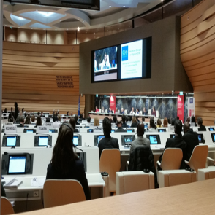
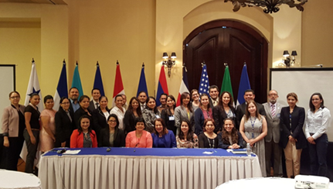
Meeting of Chairs and Secretariats of Regional Consultative Processes on migration, Switzerland, October 13th
Virtual meeting communication campaign migration children & teenagers, October 18th
Workshop identification people with protection needs Mexico, October 20th
Workshop social reintegration returned, Honduras October 26th and 27th
Meeting dialogue and cooperation civil society Honduras, October 27th-28th

Slide 5
Virtual meeting Communication Campaign on Migration of Children and teenagers October 31st
Ad-Hoc Group Extra-regional Migrants Costa Rica, November 3rd & 4th

Slide 6
12 activities
18 activities
4
Virtual meetings
2
External activities

Slide 7
1.2 Additional tasks of the Technical Secretariat
Reviewing documents and compiling a document on structure and operations
The TS reviewed historical documents (1996-2015) on the structure and operations of the RCM. The document has been submitted to all RCM Member Countries.
Follow-up actions
Support & participation in the “Workshop on practices of consular services for migrant children and adolescents" Mexico.
Tools for dissemination and interinstitutional communication
Consultation on the Terms of reference, the hiring and replacement process of the Coordinator of the T.S of the RCM.
Commemorating document.
Logos commemorating the twentieth anniversary of the RCM
New public internet page that includes a new intranet.

Slide 8
Financial Report
2.1 Annual revenues have not been sufficient to cover the actual annual costs of ST
 | Contributions received during the year | Actual operating expenses in the year | Difference between contributions received and actual operating expenses in the year
2009 | $277,639 | $232,762 | $44,877
2010 | $278,144 | $276,759 | $1,385
2011 | $277,744 | $292,106 | -$14,362
2012 | $273,042 | $273,868 | -$826
2013 | $272,688 | $294,400 | -$21,712
2014 | $272,662 | $308,394 | -$35,732
2015 | $270,771 | $305,843.33 | -$35,072.33
2016 | $260,874 | $323,205.07* | -$62,331.07**
Source: Own elaboration based on information from IOM financial systems. *Projected expenditure for the end of 2016. ** Projected difference for the end of 2016. This amount includes the expenses of moving round trip of the previous Coordinator of the TS.

Slide 9
Source: Own elaboration based on information from IOM financial systems
The negative tendency has deepen over the years. Until now, this deficit was being fought through the reserves left from previous years. This reserve finished in September 2016.
If the trend continues the TS will operate in deficit for long periods of time during the year, filling those deficits with resources "borrowed" from the next or the subsequent years.
Under present conditions, in order to resolve the current financial situation, it is necessary to increase the budget by an estimated 20%.

Slide 10
2.2 Amounts per item approved in the ST budget are not sufficient to cover the fixed costs of ST
The TS has fixed expenses, which are not adequately reflected in the categories of the budget approved annually for the operation of the TS. The clearest example is the personnel costs.
Personnel Category
Year | Approved budget | Actual expenditure | Difference
2012 | $173,779 | $165,319.97 | $8,459.03
2013 | $183,379 | $196,577.78 | -$13,198.78
2014 | $183,379 | $192,261.51 | -$8,882.51
2015 | $183,379 | $197,778.19 | -$14,399.19
2016 | $183,379 | $204,040.57 | -$-20,661.57

Slide 11
The situation repeats in the travel category and travel expenses category.
Differential between the budget approved for travel and travel expenses executed in this category - period 2012-2016
Año | Presupuesto aprobado | Gasto real | Diferencia
2010 | $13,945 | $18,017.64 | -$4,072.64
2011 | $13,945 | $14,251.92 | -$305.92
2012 | $13,945 | $12.663.70 | $1,281.3
2013 | $13,945 | $15,187.62 | -$1,242.62
2014 | $13,945 | $32,430.46 | -$18,485.46
2015 | $13,945 | $39,502.93 | -$25,557.93
2016 | $13,945 | $36,147.43 | -$22,202.43
If the approved budget categories are not reviewed, for items such as personnel costs and travel and travel expenses, it is foreseeable that these items will be permanently overdrawn.

Slide 12
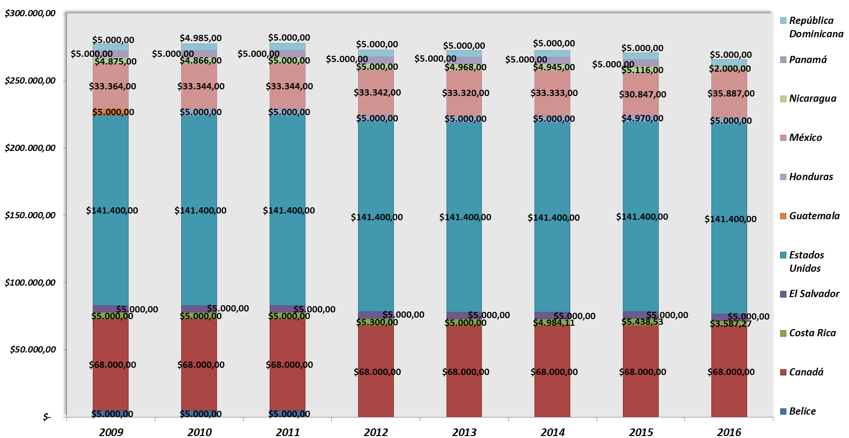
2.4 Contributions to the budget of the TS

Slide 13
Contributions received from the Member Countries to the budget of the TS during the period of 2009-2012

Slide 14
Amount owed up to september 2016, per Member Country, from 2009 to September 2016

Slide 15
2.5 Alternative means of financing the ST of CRM
Voluntary annual contribution for observer organizations
Annual contribution for new observer organizations
A fixed annual contribution for the new observer organizations, would simply reiterate its commitment to the RCM and would, in part, provide support to meet the costs of their participation in the work and meetings of the RCM that implies to the Conference.
Cover the costs arising from participation in the RCGM, the RCM and other events and seminars.
Contribute to the costs involved in the participation of the TS in the events promoted by the organizations themselves within the framework of RCM.
This voluntary contribution, in the amount of around $ 5,000 a year,would allow agencies that cannot do it, could do so without being removed from the work of the RCM
This annual contribution could be around $ 5,000 per year.

Slide 16
Registration fee for some of the participants in the RCM workshops and seminars
Contributions by some suppliers of goods or services that wish to offer said goods or services in the margins of the workshops and seminars of the CRM
Through the collection of quotas for the installation of stands or the opening of spaces, in the framework of the RCM events. These spaces would be allocated to offer goods or services to participants of the CRM events.
Accreditation and management of this contribution could be guided by the guidelines of IOM's self-payer programs.
Would apply only to those who wish to attend the event but have not originally been included in the participants of the event and to those who are not members of the RCM Member Countries or their observer organizations, but wish to participate in a particular RCM event as participants or speakers, provided that the organizers of the event agree to that participation.
Through this quota, food and other costs related to the participation can be pay for.
Funds from these contributions would be allocated to the strengthening of the TS and their accreditation and utilization could be governed by the same guidelines as the IOM self-payer programs.

Slide 17
Thank you!

