Slide 1
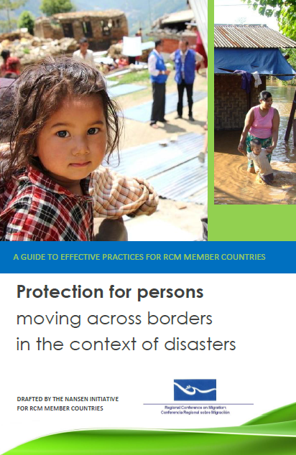
A GUIDE TO EFFECTIVE PRACTICES FOR RCM MEMBER COUNTRIES
Protection for persons moving across borders in the context of disasters

Slide 2
LÍNEA DE TIEMPO
RCM XIX Vice-Ministerial Meeting on 26-27 June 2014, Managua
Regional Workshop on Temporary Protection Status and/or Humanitarian Visas in Situations of Disaster, 10-11 February
San José
2015-2016
Comments and observations by RCM member countries
Drafted by the Nansen Initiative

Slide 3
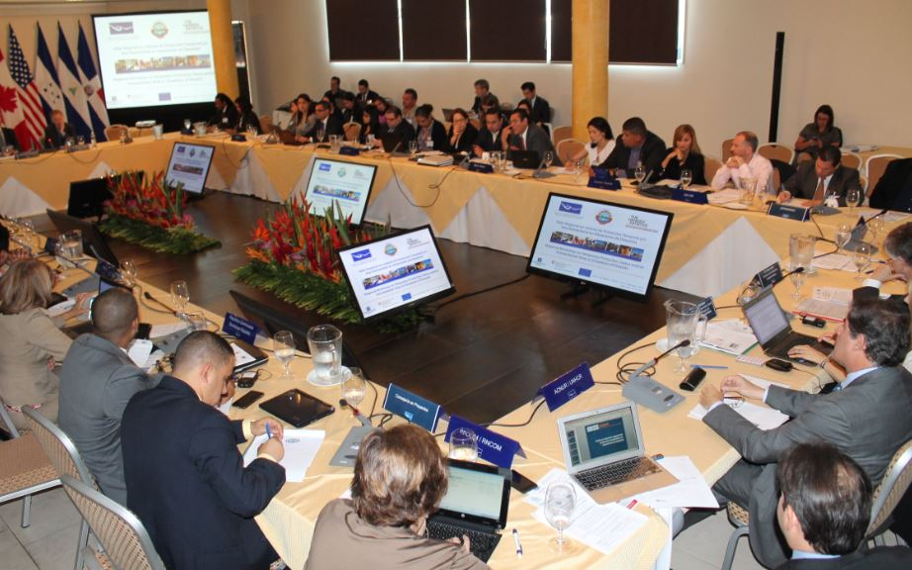
Regional Workshop on Temporary Protection Status and/or Humanitarian Visas in Situations of Disaster, 10-11 February San José

Slide 4
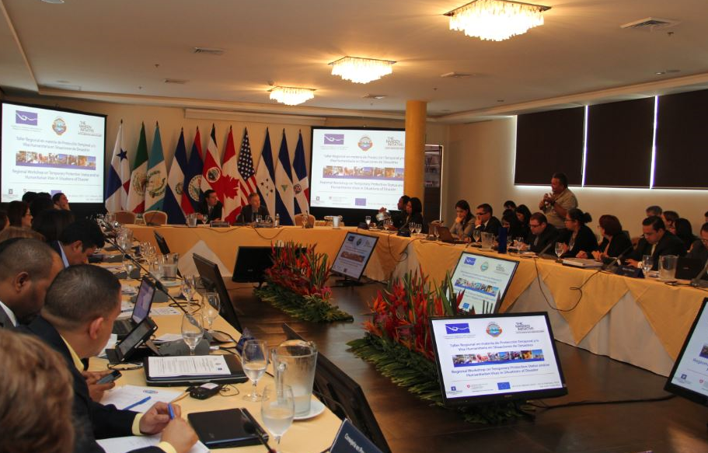
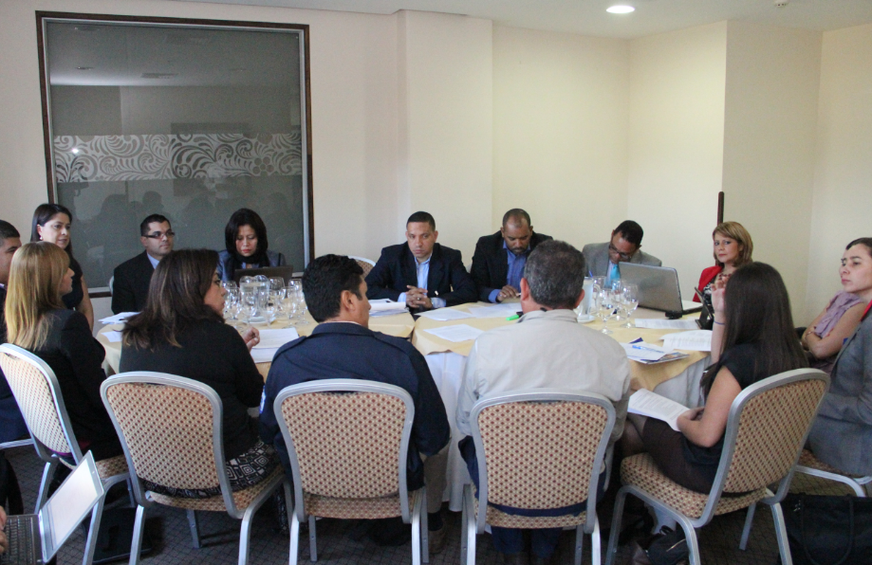
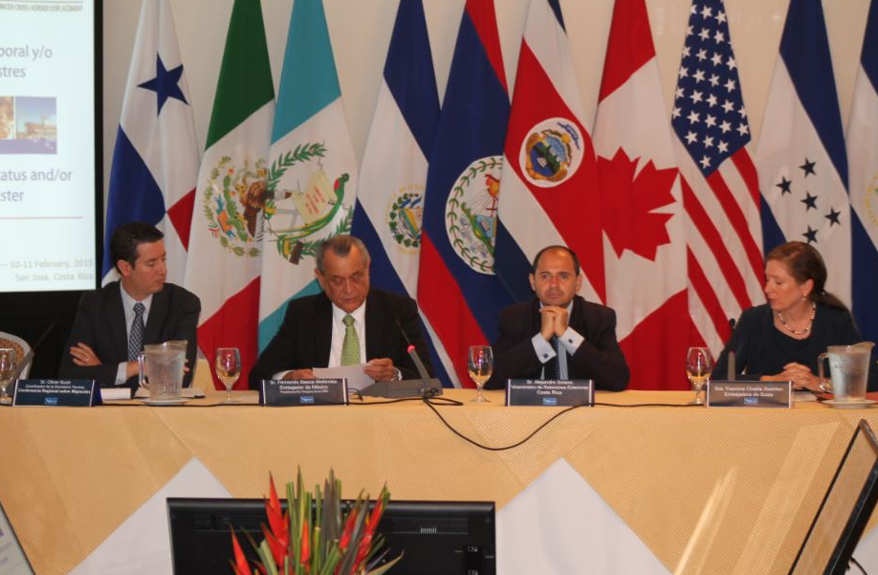

Slide 5
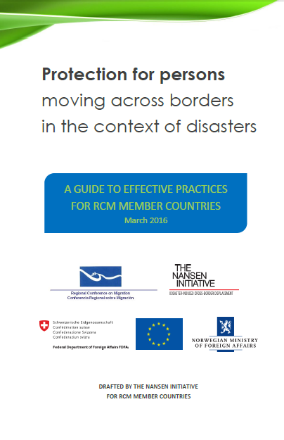
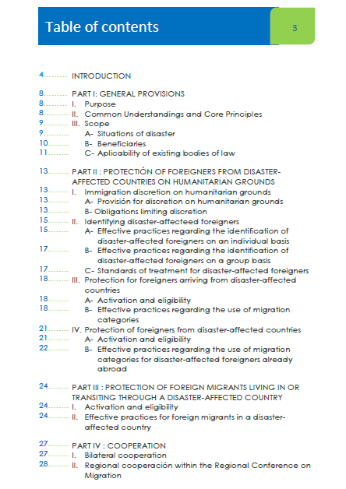

Slide 6
PART I General provisions PART II Protection of foreigners from disaster-affected countries on humanitarian grounds PART III Protection of foreign migrants living in or transiting through a disaster-affected country PART IV Cooperation

Slide 7
THANK YOU!

