Slide 1
RECORDING AND DOCUMENTING IMMIGRATION CONTROLS

Slide 2
Background
The Government of Guatemala, through the General Directorate of Migration, records data on every traveller that enters and exits Guatemalan territory.
The data that are recorded are of a biographic nature and are taken from the biographic data page of the passport.
Data are collected at all land, sea and air border checkpoints.

Slide 3
Understanding the Situation
The SECURITY standards used to store data on migration flows require more than the biographic data from the biographic data page of the passport of each traveller.
Today, biographic data from the passport of each traveller are necessary to establish migration flows but are not sufficient.
Threats and risks relating to international crime require appropriate actions and control mechanisms to prevent criminal actions.

Slide 4
Complications
International criminal organizations have already found ways to forge travel documents.
The criminal activities are of a global nature and Guatemala is not exempt from attacks, considering its geographic location in regard to the United States.
Migrant smuggling and trafficking are crimes that continuously affect our region.

Slide 5
A Proposed Solution
To record and document immigration controls based on the following elements:
Taking and storing fingerprints of each traveller;
Taking and storing a digital photo of each traveller;
Collecting and storing the data from the biographic data page of the passport of each traveller.

Slide 6
Fingerprints of Each Traveller
Enables securely storing biographic and biometric data, in accordance with the ICAO standard;
Enables securely storing biometric data, to be used to identify and verify the identity of the document holder;
Enables rendering the migration checkpoints efficient and completely safe without any human intervention.

Slide 7
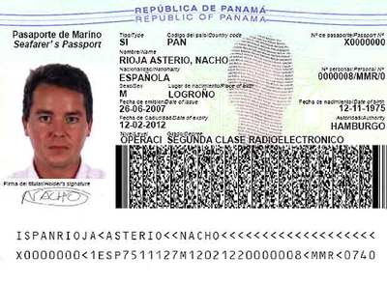
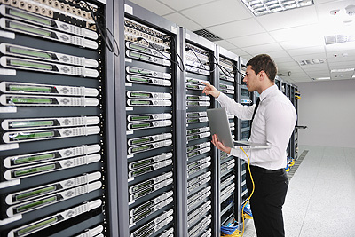
A Digital Photo of Each Traveller
Taking and storing a digital photo of each traveller;
Verification through a facial recognition system;
A secure storing system.

Slide 8
Biographic Data from Passports
Reading the biographic data from the passport;
Storing biographic data in a secure system;
Integrating biographic data with biometric data obtained through the fingerprints and the photo.

