Slide 1
ADVANCES AND NEW INITIATIVES RELATING TO CONSULAR MATTERS

Slide 2
DOCUMENTING GUATEMALAN NATIONALS ABROAD
Since August 24, 2013 the DPI (personal identity card, Spanish acronym) is the only valid document for any procedure before Guatemalan authorities, including procedures before the Consul abroad that will have a legal effect in Guatemala.
With the objective of facilitating access to the National Civil Registry of Guatemala (RENAP, Spanish acronym) to enable Guatemalan populations abroad to obtain their DPI, coordinated actions are being implemented to establish Temporary Identification Centres (CTI, Spanish acronym).

Slide 3
DOCUMENTING GUATEMALAN NATIONALS ABROAD
The Temporary Identification Centre – CTI – is a unit of RENAP provided with the required staff, furniture and equipment to record biographic and biometric data in order to issue the DPI. The unit is placed in a temporary strategic location, with accompaniment by the Ministry of Foreign Affairs, to facilitate access to this service and serve Guatemalan populations abroad.

Slide 4
STRENGTHENING AND EXPANDING THE CONSULAR NETWORK
In view of the demand for consular and immigration services by the community of Guatemalans abroad, the consular network needs to be strengthened and its coverage needs to be expanded in the United States and Mexico.
Actions that have been initiated include the allocation of additional human and financial resources to strengthen the capacity for assistance and consular protection.
Notes:
La Red Consular de Guatemala está conformada por 178 oficinas consulares, de las cuales 18 son consulados generales, 5 consulados, 2 agencias consulares, 37 secciones consulares de embajada y 116 consulados honorarios. En los Estados Unidos de América la red consular está conformada por 11 consulados generales y 1 consulado, localizados en las siguientes ciudades: Los Ángeles, San Francisco, Denver, Phoenix, Houston y McAllen, Nueva York, Providence, Silver Spring, Chicago, Atlanta y Miami. Tomando en consideración las necesidades reportadas en las oficinas consulares, el incremento en la demanda de servicios consulares y migratorios por la comunidad guatemalteca, así como, la eminente aprobación de la reforma migratoria, que permitirá a los más de ochocientos mil guatemaltecos en situación migratoria irregular obtener un permiso de trabajo y regularizar su condición migratoria. El Ministerio de Relaciones Exteriores considera de urgencia fortalecer su red consular en los Estados Unidos de América, para lo cual ha decido tomar las siguientes acciones: - Dotar de recurso humano, creación de nuevas plazas con rango diplomático, para fortalecer el cumplimiento de las funciones de asistencia, atención y protección consular. - Dotar de recursos financieros para la contratación de personal local para funciones administrativas y operativas. - Dotar de recursos financieros para cubrir los gastos adicionales de funcionamiento, equipamiento y prestación de los servicios y programas consulares y migratorios para beneficio de la comunidad guatemalteca. - Apertura de dos nuevas sedes consulares, una en Seattle, Washington Estate y otra en Omaha, Nebraska.

Slide 5
STRENGTHENING AND EXPANDING THE CONSULAR NETWORK
United States
Mexico
Phase I, second half of 2014
Monterrey, NL
Mérida, Yucatán
Phase II, first half of 2015
Villa Hermosa, Tabasco
San Luis Potosí, San Luis Potosí
Canada
Phase I, first half of 2015
Vancouver, BC
Phase II, second half of 2015
Toronto, ON
Phase I, September 2014
San Bernardino, CA
Tucson, AZ
Del Río, TX
Phase II, December 2014
San Paul, MN
Omaha, NE
Kansas City, MO
Phase III, April 2015
Seattle, WA
Oklahoma, OK
Raleigh, NC
Phase IV, July 2015
Columbus, OH
Philadelphia, PA
New Orleans, LA

Slide 6
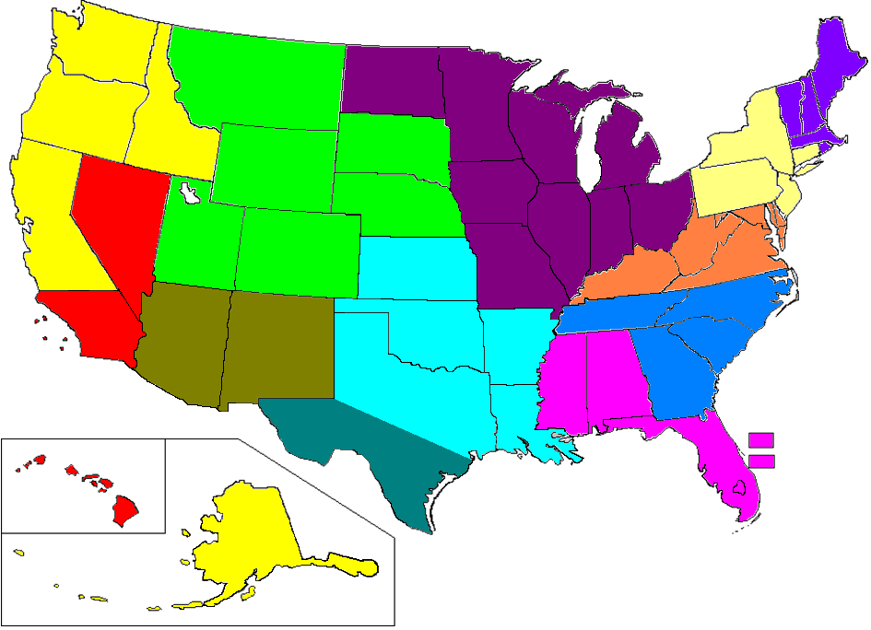
Accredited Consular Offices of Guatemala
in the United States
Washington
North Dakota
Vermont
Maine
Montana
Minnesota
Massachusetts
Oregon
New
Hampshire
Idaho
South Dakota
Wisconsin
New York
Wyoming
Michigan
Rhode
Island
Pennsylvania
Connecticut
Nebraska
Iowa
Ohio
Philadelphia
New Jersey
Nevada
Chicago
Indiana
Delaware
San Francisco
Utah
Denver
Illinois
West Virginia
Maryland
Colorado
Kentucky
Virginia
California
Kansas
Missouri
Tennessee
North Carolina
LAX
Oklahoma
Arizona
New Mexico
Arkansas
South Carolina
Atlanta
Mississippi
Alabama
Phoenix
Georgia
Louisiana
Texas
Houston
Puerto Rico
Virgin Islands
Hawaii
Florida
Miami
McAllen
Alaska
FIRST HALF OF 2014
Current Consular Offices

Slide 7
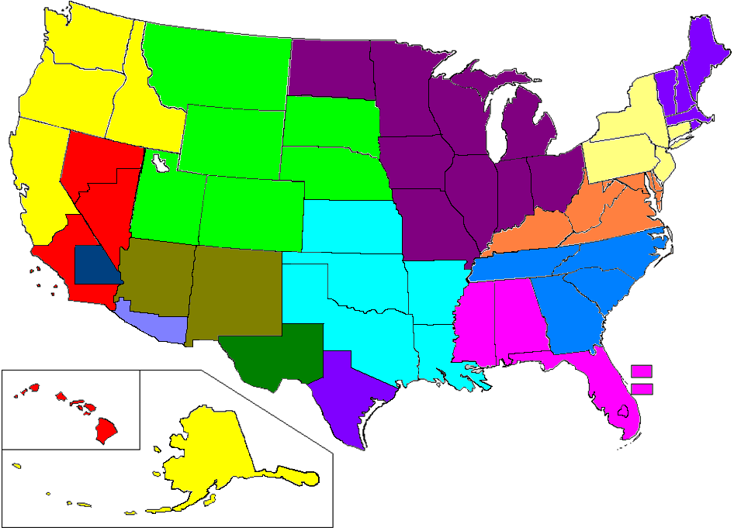
Accredited Consular Offices of Guatemala
in the United States
Washington
North Dakota
Vermont
Maine
Montana
Minnesota
Massachusetts
Oregon
New
Hampshire
Idaho
South Dakota
Wisconsin
New York
Wyoming
Michigan
Rhode
Island
Pennsylvania
Connecticut
Nebraska
Iowa
Ohio
New Jersey
Nevada
Chicago
Indiana
Delaware
San Francisco
Utah
Denver
Illinois
West Virginia
Maryland
Colorado
Kentucky
Virginia
California
Kansas
Missouri
LAX
Tennessee
North Carolina
Arizona
Oklahoma
South Carolina
San Bernardino
New Mexico
Arkansas
Atlanta
Mississippi
Alabama
Phoenix
Georgia
Tucson
Louisiana
Texas
Houston
Del Río
Puerto Rico
Virgin Islands
Hawaii
Florida
New Orleans
Miami
McAllen
Alaska
SECOND HALF OF 2014
Current Consular Offices
New Consular Offices

Slide 8
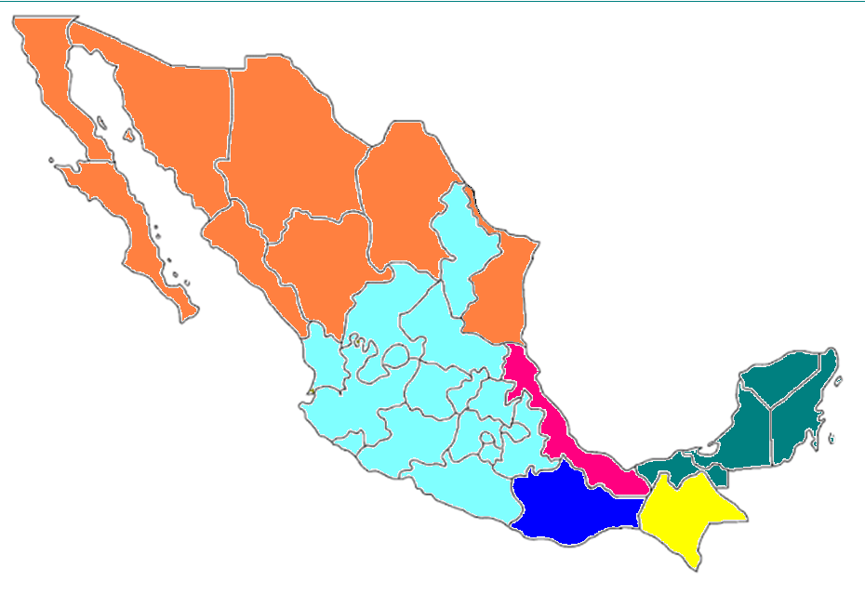
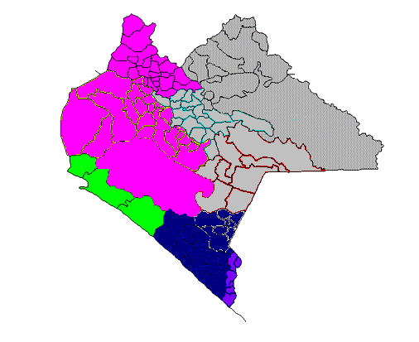
CONSULAR NETWORK OF GUATEMALA IN THE UNITED MEXICAN STATES
Tijuana
Baja
California
Sonora
Chihuahua
Baja
California
Sur
Coahuila
Sinaloa
Monterrey
Tuxtla
Nuevo
León
Comitan
Durango
Ciudad Arriaga
Mazatlán
Zacatecas
Tamaulipas
Tapachula
San Luis
Potosí
Ciudad Hidalgo
Cancún
Nayarit
Aguas
Calientes
Mérida
Yucatán
Guanajuato
Guadalajara
Querétaro
Jalisco
Hidalgo
Quintana
Roo
Michoacán
Mexico
Tlaxcala
Veracruz
Colima
D.F
Puebla
Villa Hermosa
Campeche
Mexico
Morelos
Veracruz
FIRST HALF OF 2014
Puebla
Tabasco
Guerrero
Acayucan
Tenosique
Current Consular Offices
Oaxaca
Chiapas
Consul Ad Honorem of Guatemala
Oaxaca

Slide 9
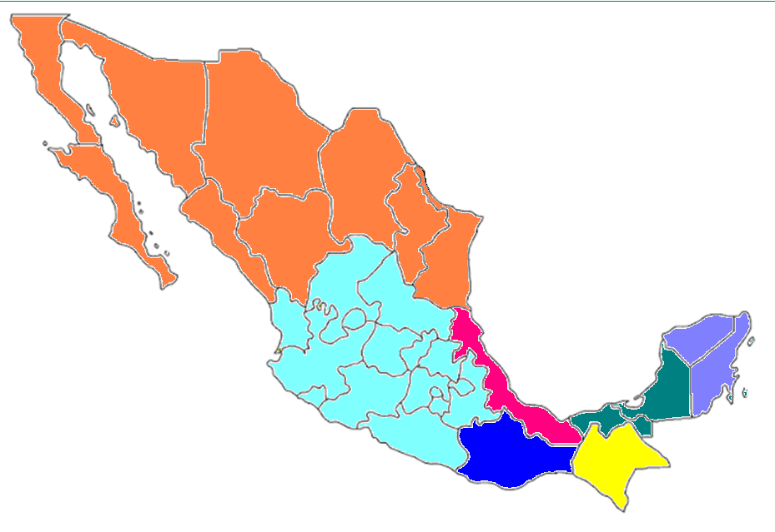
CONSULAR NETWORK OF GUATEMALA IN THE UNITED MEXICAN STATES
Baja
California
Sonora
Chihuahua
Baja
California
Sur
Coahuila
Sinaloa
Monterrey
Tuxtla
Nuevo
León
Durango
Comitan
Ciudad Arriaga
Zacatecas
Tamaulipas
Tapachula
San Luis
Potosí
Ciudad Hidalgo
Nayarit
Aguas
Calientes
Yucatán
Guanajuato
Querétaro
Jalisco
Hidalgo
Quintana
Roo
Michoacán
Mexico
Tlaxcala
Veracruz
Colima
D.F
Campeche
Mexico
Morelos
Veracruz
SECOND HALF OF 2014
Puebla
Tabasco
Tenosique
Guerrero
Acayucan
Current Consular Offices
Oaxaca
Chiapas
New Consular Offices
Oaxaca

Slide 10
CONSULAR PROTECTION
Within the framework of the Cooperation Agreement between the Ministry of Foreign Affairs of Guatemala and the International Committee of the Red Cross, several training efforts have been implemented for officers of the National Institute of Forensic Science, the Public Prosecutor’s Office and the Ministry of Foreign Affairs on implementation of a data base to search for missing migrants abroad. The objective was to learn about this tool, which will be implemented in September 2014.

Slide 11
CONSULAR PROTECTION FOR MIGRANT BOYS, GIRLS AND ADOLESCENTS
The Ministry of Foreign Affairs, led by Rosa Leal de Pérez, First Lady of the Republic, and together with the Secretariat for Social Welfare of the President’s Office, the General Directorate of Migration, the Attorney General’s Office and other State institutions of Guatemala as well as civil society organizations and international organizations addressing the topic of migrant boys, girls and adolescents, has promoted and implemented a series of actions to benefit migrant boys, girls and adolescents.

Slide 12
CONSULAR PROTECTION FOR MIGRANT BOYS, GIRLS AND ADOLESCENTS
NATIONAL ACTIONS
Designing a Public Policy on Assistance and Consular Protection; Designing a Protocol for Assistance and Protection of Migrant Boys, Girls and Adolescents and a Mechanism to Determine the Best Interest of the Child; Promoting a bilateral mechanism for consular notification and assistance in detention, shelter and reunification of migrant boys, girls and adolescents; High-level work visit to the border region, facilities and shelters.

Slide 13
CONSULAR PROTECTION FOR MIGRANT BOYS, GIRLS AND ADOLESCENTS
VISITS TO THE BORDER REGION: Visits have been made to Phoenix and Tucson, and McAllen y Brownsville in May, to observe the situation, speak with relevant authorities and visit shelters.
COORDINATION WITH AUTHORITIES: We are working in close collaboration with authorities of the Border Patrol, Immigration, the Office for Refuge and Resettlement and Shelters.
ON-GOING MONITORING ACTIONS: Consulates at the border continuously visit the stations of the Border Patrol, detention centres and shelters to coordinate actions with relevant authorities in order to provide assistance to Guatemalan nationals and ensure respect for their rights and due process and humane, dignified and respectful treatment and conditions.
FAMILY NOTIFICATION: Families are informed about the detention of their relatives and guidance is provided in regard to processes of reunification in the United States or return to Guatemala.
GUIDANCE FOR DETAINED PERSONS: Detained persons are interviewed during visits to stations, detention centres and shelters, and guidance is provided about the situation they face and the process of reunification in the United States (for boys, girls and adolescents) or return to Guatemala.

Slide 14
Consular Assistance and Protection Programmes
The Ministry of Foreign Affairs prioritizes assistance and protection for the community of Guatemalans abroad, Guatemalans in transit toward their countries of destination, and assisted return to their communities of origin.
In this regard, the following programmes continue to be strengthened:
Programme for assistance to deceased and vulnerable Guatemalans abroad;
Programme to search for missing Guatemalans abroad;
Programme for humanitarian aid to Guatemalans returned from the United States by air and from Mexico by land;
Mobile Consulates;
Consular Saturdays;
Programme for migration assistance and guidance;
Videoconference programme.

Slide 15
PROGRAMME FOR HUMANITARIAN AID TO GUATEMALANS RETURNED FROM THE UNITED STATES BY AIR
MONTH
adults
children
subtotal
Total no. deported
flights
male
female
male
female
male
female
JAN.
FEB.
MAR.
APRIL
MAY
JUNE

Slide 16
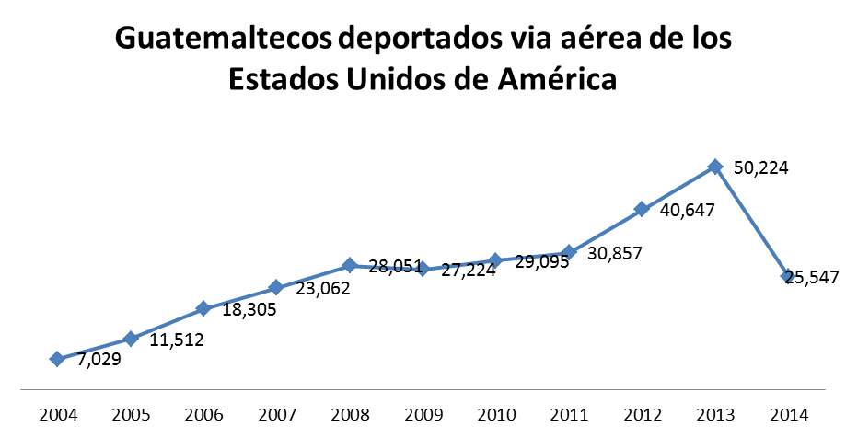
GUATEMALANS DEPORTED FROM THE UNITED STATES BY AIR
YEAR
DEPORTED
BY AIR
GUATEMALANS DEPORTED FROM THE
UNITED STATES BY AIR

Slide 17
Guatemalans returned from Mexico by land
MONTH | ADULTS |  | BOYS, GIRLS AND ADOLESCENTS |  | TOTAL IN 2014
 | MEN | WOMEN | MEN | WOMEN
JANUARY | 1,693 | 225 | 162 | 40 | 2,120
FEBRUARY | 2,050 | 291 | 249 | 61 | 2,651
MARCH | 2,726 | 500 | 252 | 75 | 3,553
APRIL | 1,912 | 369 | 187 | 79 | 2,547
MAY | 1,842 | 327 | 298 | 121 | 2,588
JUNE | 109 | 15 | 2 | 4 | 130
TOTAL | 10,332 | 1,727 | 1,150 | 380 | 13,589

