Slide 1
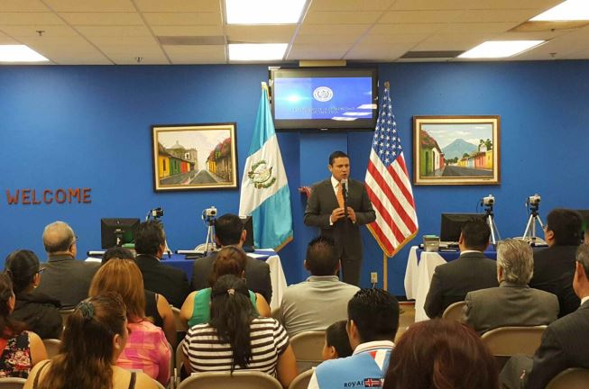
New Actions and Best Practices in Consular Protection

Slide 2
SEARCHING FOR MISSING GUATEMALANS
The Ministry of Foreign Affairs, through the General Office for Consular and Migration Affairs, provides assistance to relatives of Guatemalans who have gone missing abroad.
Coordination:
Public Prosecutor’s Office
Forensic Anthropology Foundation of Guatemala
Mariano Gálvez University of Guatemala
National Institute of Forensic Science of Guatemala -INACIF
Ministry of Foreign Affairs

Slide 3
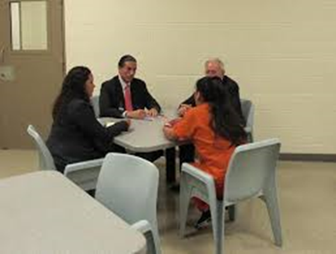
Interviewing Techniques
Assistance to Victims
Database Management
Identifying Mortal Remains
Self-care
The strategic alliance of the Ministry of Foreign Affairs and the International Committee of the Red Cross (ICRC) has provided training for consular officers on the following topics:

Slide 4
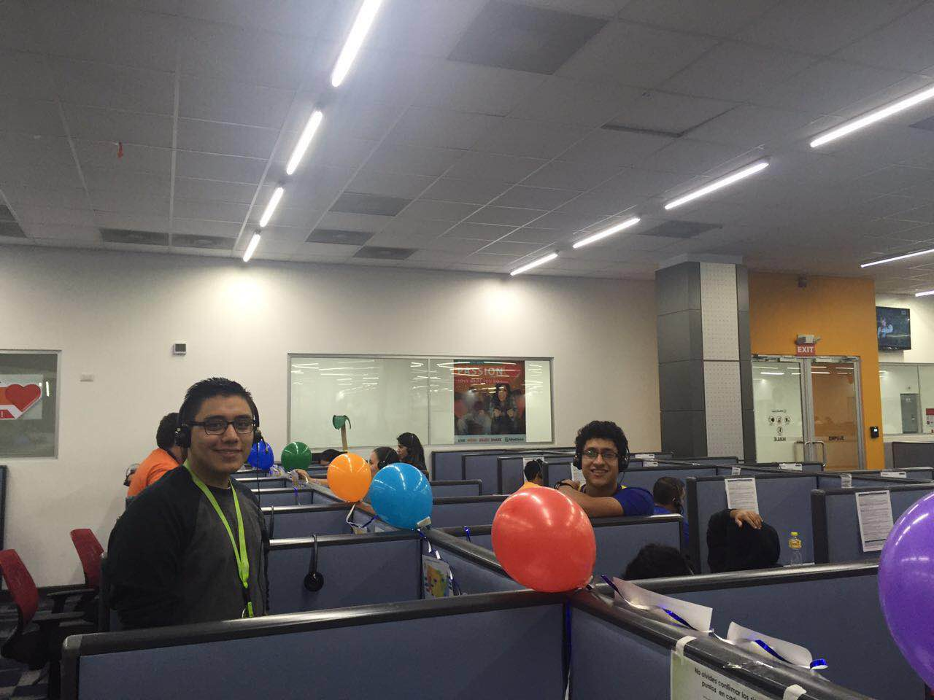
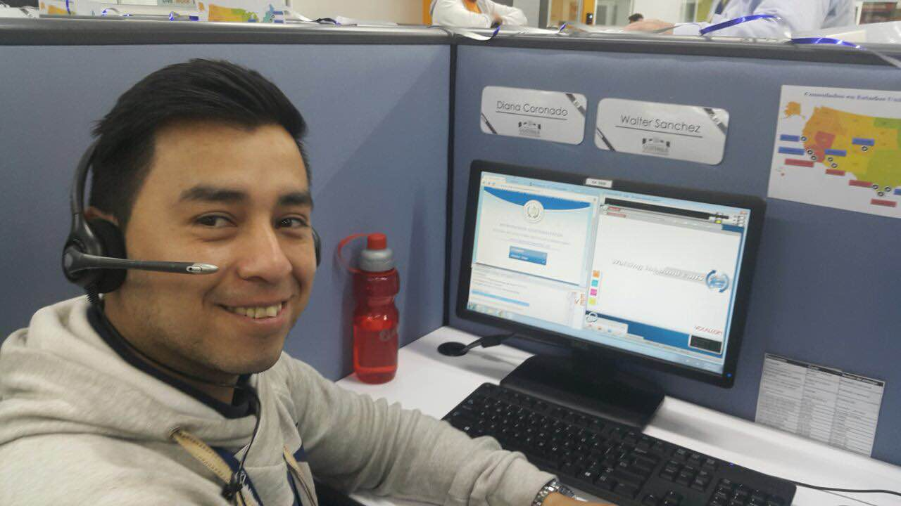
ATENCIÓN AL MIGRANTE (Assistance to Migrants) CALL CENTRE

Slide 5
A call centre for assistance to migrants (Atención al Migrante) was established with the aim of strengthening the Consulates of Guatemala in the United States, improving assistance for Guatemalans abroad and ensuring their well-being through dignified, humane, efficient, effective and immediate response services.

Slide 6
General Information:
Targeted Population | Guatemalans requiring services from Consulates of Guatemala in the United States
Purpose | To provide assistance to persons inquiring about consular services provided abroad, such as document issuance: passports, identity cards, consular identity cards, birth certificates, marriage certificates, death certificates, legalization of documents, etc. In addition, through the call centre Guatemalans can make appointments to obtain any of the documents issued abroad.
Office Hours | 6:00 am - 11:00 hpm (Guatemalan time) Monday through Saturday; Sunday closed. For calls outside office hours a recording is available with information about the requirements for obtaining documents such as passports, identity cards and consular identity cards.
Languages | Spanish Q´echi, K´iche, Kakchiquel, Q´anjoba´al and Poqomchi English
Number of Assistants | 25

Slide 7
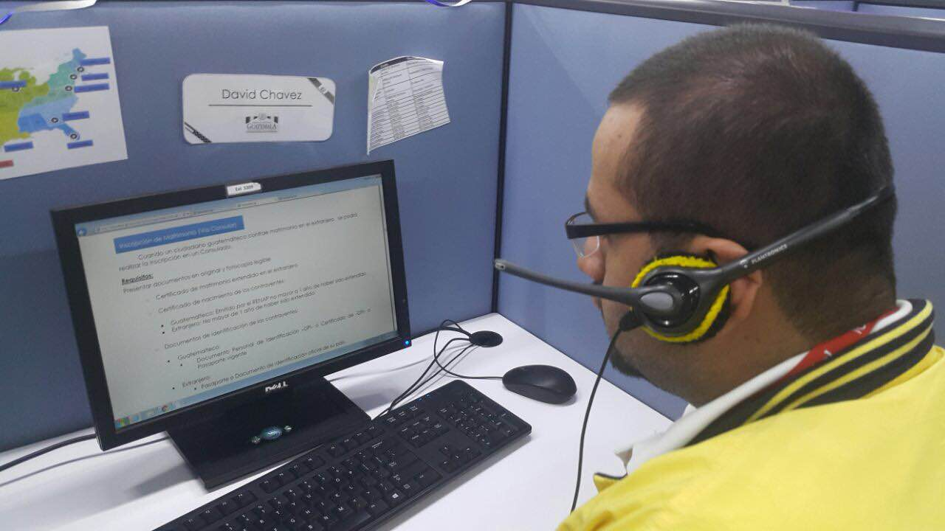
Implementation
A single number of the call centre
A free telephone number to call from the United States

Slide 8
Advances
Metrics
From April 14 (start of operations) to October 31, 2016, 280,780 calls have been received from all Consulates of Guatemala in the United States;
Languages: 95.32% of the callers were assisted in Spanish, 1.56% in English and 3.12% in Mayan languages (Q´echi, K´iche, Kakchiquel, Q´anjoba´al and Poqomchi).

Slide 9
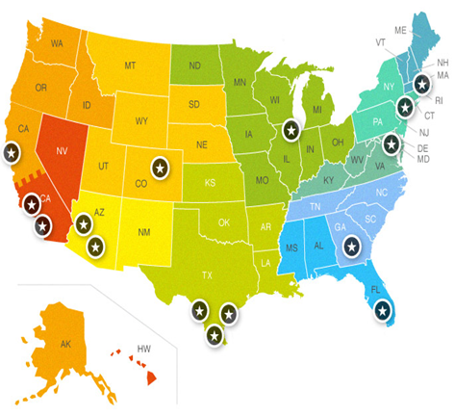
EXPANDING THE CONSULAR NETWORK IN 2016
United States
Lake Worth, Florida
Mexico
Monterrey, Nuevo León
Seattle, Washington
Oklahoma City, Oklahoma
Raleigh, North Carolina
A change of category is envisaged for several consular offices and consulates.

Slide 10
RECEPTION CENTRE IN Tecún Umán, San Marcos
The reception centre commenced operations on December 17, 2015 with the objective of providing a physical facility for returned persons to improve immigration control actions for persons entering the country and provide basic services and guidance on access to humanitarian aid or reporting rights violations in Mexico.

Slide 11
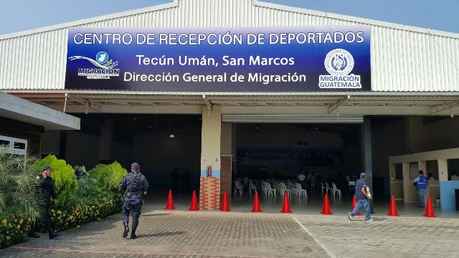
Ministry of Foreign Affairs
International Organization for Migration
General Migration Office
International Committee of the Red Cross
Missionaries of St. Charles, Scalabrinians
Human Rights Ombudsman’s Office
Secretariat of Social Welfare of the President’s Office
Public Prosecutor’s Office
Intersectoral Coordination

Slide 12
LEGAL ATTACHÉS
Through the Inter-Institutional Cooperation Agreement for the Establishment of Legal Attachés in the Diplomatic Missions of Guatemala Abroad, the Ministry of Foreign Affairs and the Public Prosecutor’s Office have appointed a Legal Delegate of the Public Prosecutor’s Office at the Embassy of Guatemala in Mexico City.
Objective
To enable migrant communities to file reports, and to follow up on each case.

Slide 13
THANK YOU!

