Slide 1
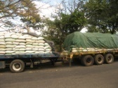
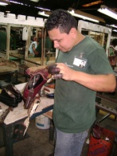
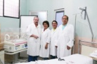
the role of consular management within the programme for temporary workers abroad
Seminar/Workshop on Capacity Building of Consular Officers for the Protection of the Labour Rights of Migrant Workers
Managua, Nicaragua may 3 – 4, 2012

Slide 2
EXECUTING INSTITUTIONS OF THE PROGRAMME FOR TEMPORARY WORKERS ABROAD
Ministry of Labour and Social Welfare
Ministry of Foreign Affairs
International Organization for Migration

Slide 3
CONTEXT
The dynamics of migration in El Salvador
Labour policy
Policy on assistance and protection for migrants
Re-structuring the diplomatic and consular network in El Salvador
Migration management with a development approach

Slide 4
VICE-MINISTRY FOR SALVADORANS ABROAD
Strategic Vision:
To be an institution that potentiates and promotes the comprehensive development of migrants and their families with a rights approach, as a horizon for programmes, projects, and interventions, potentiating the comprehensive development of migrants and their families.

Slide 5
VICE-MINISTRY FOR SALVADORANS ABROAD
Strategic Vision:
Projects, actions, and interventions by the Vice-Ministry are based on a rights approach.
The general objective of interventions shall be to promote, defend, and protect the rights of Salvadorans abroad or in transit.
For each intervention and project, it is identified what rights should be compensated, promoted, and restored.
Definitely, this is about examining , for each case, what rights have been violated and what rights need to be guaranteed.

Slide 6
VICE-MINISTRY FOR SALVADORANS ABROAD
Legacy of the Vice-Ministry:
To implement the institutional design and practice of protecting and defending the human rights of migrant populations and their families, and to ensure inclusion and active participation of these populations in public development policy at a local and national level.
Abroad, through protection consulates, firstly along the Arriaga and Comitán Migration Route.
Legal aid (pilot project in the US).
Awareness-raising of consular officers (developing a module on human rights focused on protection for migrants).

Slide 7
Key Labour Policies
To develop strategies promoting labour mediation at a national and international level, including equal opportunities with a gender approach, for youth, disabled persons, senior citizens, women heads of households, and the population in general.
To support, through the National Employment Network, strategies facilitating an intensive generation of labour at a national level.
Implementing a national employment policy, within the framework of the Five-Year Plan 2009-2014 of the Government of El Salvador.
To promote and implement employment and decent work, identifying employment opportunities abroad through Programmes for Temporary Foreign Workers Abroad.
To promote the design of a recruitment, selection, and monitoring system for temporary workers abroad (under the temporary labour migration management model in El Salvador).

Slide 8
Occupation Levels according to the Multiple Purpose Home Survey
Year Employed Population Unemployed Pop. Unemployment Rate
2004 2,526,363 183,874 6.78 %
2005 2,591,076 201,556 7.22 %
2006 2,685,862 188,746 6.57 %
2007 2,173,963 146,983 6.33 %
2008 2,349,050 146,858 5.88 %
2009 2,551,667 187,088 7.30 %
2010 2,580,284 181,806 7.10 %

Slide 9
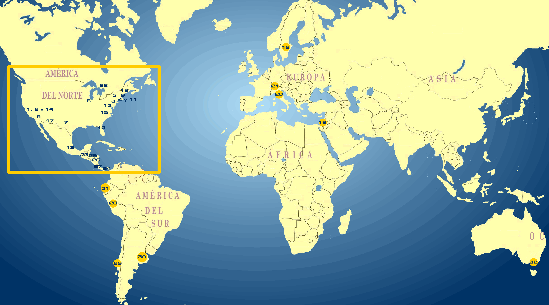
Migration Context
120,000
2,500,000
+ ó - 80 000
+ ó - 100,000
Approximately 2.8 million Salvadorans are living abroad.
90% of migrants are living in the US.
Geographic location in other countries: Canada, Central America, Mexico, Australia, Italy, Sweden, etc.
3,000
19,000

Slide 10
Migration and Development
Strategic Objectives
Under the migration and development approach through which the Government of El Salvador seeks to address the dynamics of migration of the country, three strategic objectives have been established:
To achieve that Salvadorans abroad and their families take ownership of their rights and participate actively in national and territorial development processes.
To strengthen links of Salvadorans abroad with their country and communities of origin.
To provide comprehensive consular services, ensuring a dignified high-quality treatment for all Salvadorans abroad and their families.

Slide 11
A Model for the Management of Temporary Employment Abroad
A comprehensive instrument to manage the regular and orderly movement of temporary workers, guaranteeing respect for their rights and promoting their development and participation in development processes of the territories through complementary programmes.
Notes:
Aca vamos a introducir el modelo de gestión como instrumento que nos permite desarrollar otros programas de fortalecimiento de las remesas

Slide 12
A Model for the Management of Temporary Employment Abroad
To manage safe and positive circular temporary labour migration for Salvadoran workers, with the aim of helping them improve their living conditions and those of their families in El Salvador.
To ensure that the Salvadoran workers that are selected to work abroad are hired in a temporary manner under conditions of decent work, in accordance with international norms.

Slide 13
A Model for the Management of Temporary Employment Abroad
3. To help raise the labour profile of Salvadoran workers by enabling them to gain new knowledge and techniques in the country of destination where they work.
4. To link actors of the programme with other strategic actors in order to implement development efforts in El Salvador in the communities of origin of the hired workers.

Slide 14
The Role of Consulates within the Temporary Employment Management Model
Under the migration management vision and within the framework of protecting the rights of migrants, Salvadoran consulates take on the following responsibilities:
Receiving temporary workers in the country of destination
Monitoring the migration movement of temporary workers abroad
Visiting work sites
A data base on migrant workers
Consular services / mobile consulates

Slide 15
The Role of Consulates within the Temporary Employment Management Model
Monitoring the conditions of workers and their performance in the enterprises that have hired them.
A debriefing session with representatives from the hiring enterprises at the end of the employment period.
Seeking employment offers.

Slide 16
Complementary Programmes
Incorporated into Migration Management
Capacity-building for the institutions coordinating this management model
Distance education programmes, high school level
A talent and knowledge transfer programme
A financial education programme
A programme to maintain family links

Slide 17
Lessons Learned
Establishing roles, responsibilities, coordination mechanisms, and communication mechanisms between all actors involved in the programme processes grants more credibility to the management of the programme.
Capacity-building for government actors involved in managing the process of temporary employment has a positive impact on the operations of the programme.
Promoting the search for supporting networks among consulates could facilitate providing guidance to temporary workers in certain situations (legal aid, migration assistance, adjusting to another culture, language training, etc.)

Slide 18
Lessons Learned
Under this programme, consulates with the potential in their jurisdictions to manage employment offers or where fellow citizens are already working should take on a proactive attitude of communication and follow-up with hiring enterprises and communication and monitoring with Salvadorans working in these enterprises.
Accompanying the technical management of the programme with high-level political actions (agreements between States, for example) supports consular actions to protect Salvadorans and to negotiate new employment offers .
Entering into alliances with other public and private actors in the country of origin helps strengthen the management of the programme and increase the benefits for migrant workers.

Slide 19
Lessons Learned
The temporary nature of the work experience available to Salvadoran workers should be highlighted, with the aim of ensuring that this is not used as a window to promote permanent migration.
Time should be allocated to preparing the departure of workers toward their places of destination, with the aim of providing them with tools and knowledge that will be useful in the new context where they will live and work.
During the process of announcing employment offers the most appropriate dissemination mechanisms should be sought, with the aim of avoiding an excessive offer of workers wishing to join the programme.

Slide 20
Lessons Learned
Ensuring access of Salvadoran workers to the social welfare and social security system of El Salvador continues to be a challenge, especially upon their return.
Another challenge is improving labour market intelligence with the aim of establishing a system that informs about trends and projections of Salvadoran labour within a global context.

Slide 21
Contacts
Ministry of Foreign Affairs
José Manuel Castillo P-G Directorate for Strengthening Organizations of Salvadorans Abroad Vice-Ministry for Salvadorans Abroad
jcastillo@rree.gob.sv
For more information on the migration and development strategy of the Ministry of Foreign Affairs, visit
www.rree.gob.sv/videoipad

