Slide 1
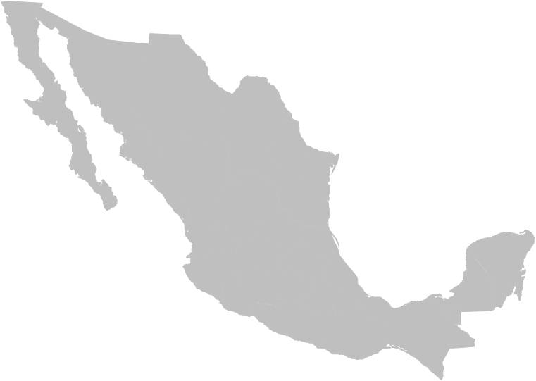
NATIONAL REPORT ON MIGRANT SMUGGLING AND TRAFFICKING AND PRESENT AND FUTURE CHALLENGES IN COMBATING THESE CRIMES
June 2012

Slide 2
INTRODUCTION
Southern Border of Mexico
Migration, commercial, financial, and tourist flows converge;
Difficult geopolitical and social conditions;
Illegal activities and local, national, and international networks.
The Phenomenon of Migration
Vulnerable situations of migrants;
Convergence with organized crime;
Crimes committed risk for institutions of the Mexican State.
The National Report
A strategic vision at the southern border, based on the presence of organized crime;
Generating institutional cooperation mechanisms to investigate and prosecute the crimes of migrant smuggling and trafficking.

Slide 3
TRAFFICKING IN PERSONS
Southern Border
Origin Irregular Migration
-- Regional
Transit -- Extra-continental
Destination
2006 – 2011: Global economic crisis + labour crisis + stricter migration policy in the United States = a significant reduction in migration flows = presence of criminal groups in Mexico = increasing vulnerability of migrants in transit.
Foreign nationals sheltered by INM in 2006: 182,705.
Foreign nationals sheltered in 2011: 66,764.
Decrease: 36.54%.
Nationalities: 33,006 from Guatemala, 19,425 from Honduras, 9,103 from El Salvador, 978 from the United States, 748 from Nicaragua, 758 from Cuba, 539 from Ecuador, 451 from India, 232 from Colombia, 179 from China, 136 from Eritrea, 112 from Venezuela, and 1,097 from other countries.

Slide 4
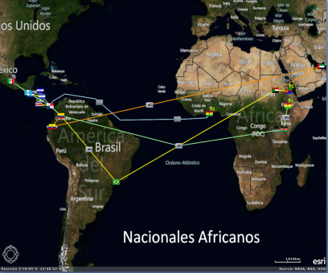
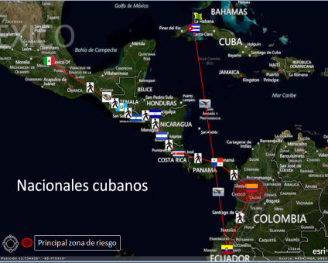
Extra-continental Migrants
Extra-continental Migrants Sheltered in 2011
Asians: 831 sheltered (149 repatriated);
Africans: 287 sheltered (11 repatriated);
Cubans: 758 sheltered (a significant increase); 71.63% entered through Chiapas (130 repatriated).
Cuban Nationals
African Nationals

Slide 5
Extra-continental Migrants
Routes of extra-continental migrants in transit through Mexico:
17 routes identified;
43.75% arrived in Guatemala by air;
Causes: Visa waiver for certain countries.
Transit routes in Mexico
Nine routes were identified in 2011;
Some coincide with the routes for firearm and drug smuggling from Central America.
See the two next slides.

Slide 6
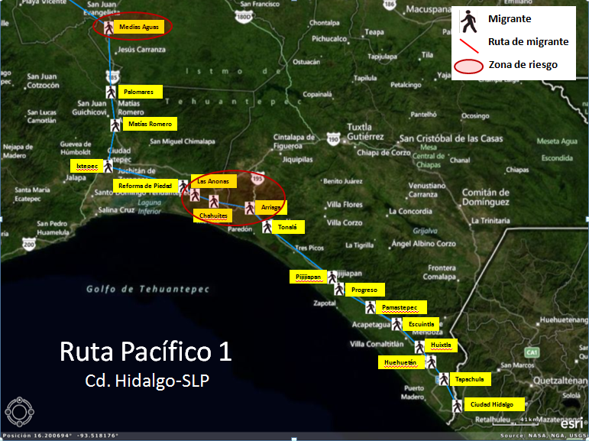
Extra-continental Migrants (Routes)
Pacific Route 1

Slide 7
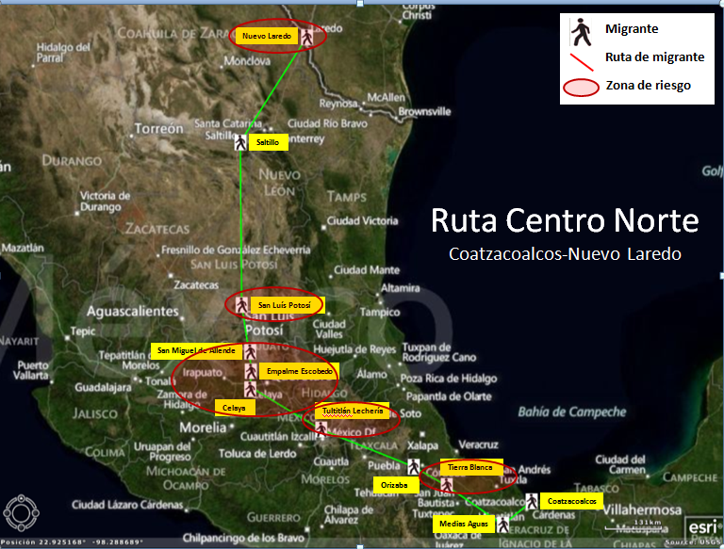
Extra-continental Migrants (Routes)
Centre-Northern Route

Slide 8
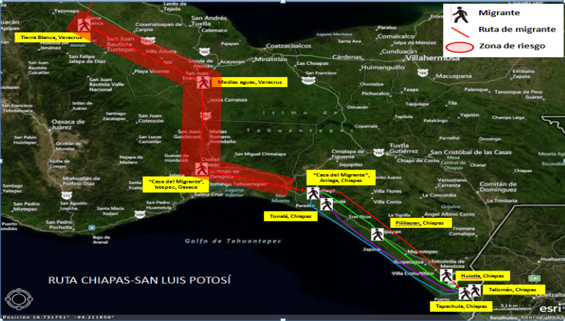
Risk Routes
Testimonies of migrants victims of abduction = Three routes have been identified;
Place of origin: Chiapas and Tabasco, with records of violent incidents and abduction of migrants;
Places of highest risk: Tenosique, Tabasco; Orizaba, Coatzacoalcos, and Tierra Blanca, Veracruz and Ciudad Ixtepec, Oaxaca.

Slide 9
Institutional Actions
Most frequently used means of transportation: By land (public transport, private vehicles, and train);
The Federal Government has increased the number of actions on highways, railways, and bus stations;
Actions implemented by INM in 2011: 14,905 migration controls on highways (38,576 migrants identified); 504 controls on railways (3,593 migrants identified), and 15,902 migration verification visits (639 migrants identified);
Actions by the Federal Police, through the Regional Security Division: rescuing and detention of irregular migrants in the states of Campeche (113), Chiapas (2,416), Quintana Roo (320), and Tabasco (140);
Strategic intelligence actions, tactics, and actions to combat and prosecute migrant smuggling in 2011: 51 active organizations involved in trafficking in persons were identified in the states of Baja California (8), Chiapas (24), Coahuila (1), Mexico (2), Oaxaca (1), Puebla (1), Quintana Roo (3), Sonora (1), Sinaloa, (1),Tabasco (5),Tamaulipas (1), Veracruz (3). 145 persons involved in the networks were identified.

Slide 10
TRAFFICKING IN PERSONS
Women Transnational criminal organizations
Girls Regional criminal organizations
Boys Local criminal organizations
Domestic criminal organizations
Modes of operating that facilitate committing the crime;
Use of state-of-the-art technologies and infrastructure to operate and recruit (recruiting victims anywhere around the world);
Real-time operations.
The primary area of recruitment in Mexico is the south-eastern region of the country;
Intelligence: In 2011, ten states were identified with the highest rate of exploitation sites;
More than 54 locations where victims are exploited.
Trafficking in Persons

Slide 11
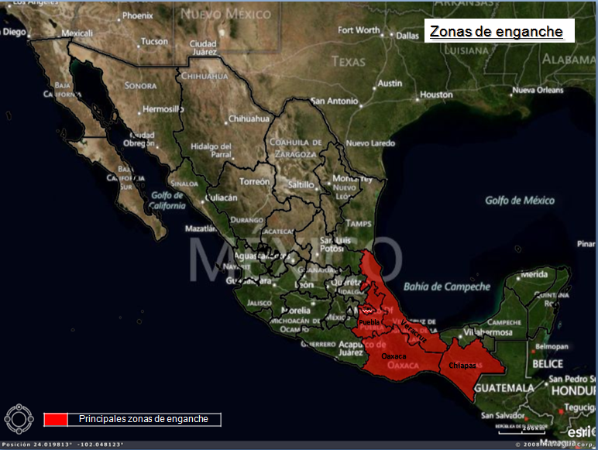
Recruitment Areas
Recruitment Areas

Slide 12
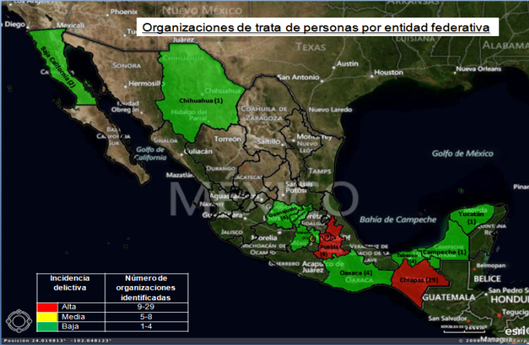
Local Criminal Organizations
In 2011, the intelligence service of Mexico identified 72 active trafficking networks: 29 in Chiapas, 9 in Puebla, 9 in Tlaxcala, 8 in the Federal District, 4 in Oaxaca, 4 in Tabasco, 2 in Guanajuato, 2 in Baja California, 1 in Campeche, 1 in Chihuahua, 1 in the state of Mexico, 1 in Querétaro, and 1 in Yucatán; composed of 158 men and 73 women.
Trafficking organizations by state

Slide 13
Institutional Actions
PGR (FEVIMTRA), 2011: 238 prior investigations (38 brought before the authorities);
Regional Committee on Trafficking and Migrant Smuggling: To align actions of intelligence, ministries, and police forces through an operative working group, with representatives from federal institutions and the Attorney General’s Office, to face these criminal groups.
Establishment and consolidation of mechanisms to combat the crime, such as: -- Inter-Secretarial Committee to Prevent and Punish Trafficking in Persons (CIPSTP); --- Technical Support Group of the Framework Agreement to Prevent and Combat the Abduction of Migrants;
-- Working groups and sub-committees in various institutions.
Multilateral, regional, and bilateral cooperation: Within the international sphere, Mexico actively promotes the strengthening of multilateral, regional, and bilateral cooperation to actively combat migrant smuggling and trafficking, favouring full implementation of existing mechanisms and forums.

Slide 14
Institutional Actions
General Act to Prevent, Punish, and Eradicate the Crimes Relating to Trafficking in Persons and Protect and Assist Victims of these Crimes
Advances in regard to prior legislation
Establishes responsibilities and coordination mechanisms among federal, state, Federal District, and municipal governments;
Typifies the crime of trafficking in persons and related crimes and punishment.
Establishes the obligation for PGR to create a programme for the protection of victims and witnesses;
Redefines the composition, organization, operations, and authority of the Inter-secretarial Committee;
Includes a chapter on preventing the crime, policies and programmes, identifying areas and groups that are most vulnerable, and policymaking to provide priority assistance;
Crimes related to trafficking in persons, considered to be serious and committed by organized crime groups;
Warning systems and immediate action protocols to search for and locate boys, girls, and adolescents that have been abducted, together with members of the system, emergency organizations, the media, telecommunications service providers, NGOs, and the general public.

Slide 15
Institutional Actions
General Act to Prevent, Punish, and Eradicate the Crimes Relating to Trafficking in Persons and Protect and Assist Victims of these Crimes
Criminal types that have been reformed or added:
Slavery;
Servitude;
3. Prostitution of others or other forms of sexual exploitation;
4. Labour exploitation;
Forced labour or services;
Forced beggary;
Involving persons under 18 years of age in criminal actions;
8. Illegal adoption of a person under 18 years of age;
Forced or servile marriage;
Smuggling organs, tissues, and cells of living human beings;
Illegal biomedical experiments on human beings.

Slide 16
TASKS BEING CARRIED OUT
Consolidating mechanisms to exchange criminal intelligence among security institutions, justice administrators, and border control and regulation institutions with the aim of developing strategies, plans, and strategic actions/operative tactics through identifying members, capacities, networks, modes of operating, etc., especially at the southern border;
Strengthening intelligence gathering to address and prosecute cases based on testimonies of victims and best evidence-based investigation techniques;
The federal institutions should work in close collaboration with Casa del Migrante shelters, assistance centres, and shelters of civil society organizations located on national territory;
In addition to coordinated efforts and information exchange between federal and state institutions, involving intelligence units of financial and public credit institutions to establish the Money Route of criminal organizations with the aim of identifying the behaviour patterns of these networks.

Slide 17
TASKS BEING CARRIED OUT
Consolidating joint efforts by authorities involved in combating migrant smuggling and trafficking;
Increasing border controls through state-of-the-art technology capable of detecting use of false documents in a timely manner and thus, combating the method used by trafficking networks;
Consolidating the use of biometrics in Mexico with the aim of helping to prevent the establishment, consolidation, and sophistication of organized crime networks in the country;
Providing assistance to extra-continental migrants and persons of other special nationalities with the aim of identifying transnational criminal networks;
Improving, deepening, and expanding schemes and mechanisms for cooperation with countries in the region based on the principle of shared responsibility;
Strengthening coordination between the three levels of government to strengthen public policymaking and implementation oriented toward prevention.

Slide 18
Thank you

