Slide 1
Panama
United in One Heart
Against Trafficking in Persons

Slide 2
Meeting of the Liaison Officer Network to Combat Migrant Smuggling and Trafficking
Panama – Report on new efforts and best practices in combating migrant smuggling and trafficking, with an approach of shared responsibility
San Pedro Sula, Honduras, November 15, 2016

Slide 3
National Commission Against Trafficking in Persons
To carry out the commitments established in international instruments, Article 12 of Act 79 of November 9, 2011 stipulates the establishment of the National Commission Against Trafficking in Persons as a technical administrative body, with legal status, attached to the Ministry of Public Security, with the Directive Council as its highest decision-making body.

Slide 4
National Commission Against Trafficking in Persons
Article 11 of Act 79 of November 9, 2011 establishes that the National Commission Against Trafficking in Persons is in charge of the design, execution and follow-up on the National Plan and Policy Against Trafficking in Persons;
The Directive Council of the National Commission Against Trafficking in Persons is in charge of promoting the establishment of committees and technical units as operating bodies of the National Commission;
Furthermore, Act 79 of November 9, 2011 establishes the creation of the Technical Unit for Identification of and Assistance to Victims to carry out relevant tasks. The Technical Unit is in charge of identifying and providing primary assistance to potential victims of trafficking in persons.

Slide 5
National Commission Against Trafficking in Persons
The National Commission will have the following duties:
Designing the National Policy Against Trafficking in Persons, promoting its approval and adopting the necessary actions for the comprehensive management of the public institutions involved in prevention, assistance and suppression of the crime of trafficking in persons;
Proposing, leading, promoting, disseminating and supervising the development, follow-up, execution and updating of the National Plan Against Trafficking in Persons.
Article 14, Act 79 of November 9, 2011

Slide 6
National Commission Against Trafficking in Persons
The structure of the National Commission will be as follows:
1. Directive Council;
2. General Secretariat;
3. Technical Committees;
4. Technical Units.
Article 15, Act 79 of November 9, 2011

Slide 7
National Commission Against Trafficking in Persons
The Directive Council will be the highest decision-making body of the National Commission and will be comprised of the following members, who will exercise their functions ad honorem:
1. The Minister of Public Security as chair;
2. The Minister of Government;
3. The Minister of Foreign Affairs;
4. The Minister of Labour and Labour Development;
5. The Minister of Social Development;
6. The Minister of Education;
7. The Minister of Health;
8. The President of the Supreme Court of Justice;
9. The President of the National Assembly;
10. The Public Prosecutor of the Nation;
11. The Manager of the Tourism Department of Panama;
12. The Director of the National Women’s Institute;
13. The Director-General of the National Secretariat for Children, Adolescents and Family;
14. The Human Rights Ombudsman;
15. The President of the Chamber of Commerce, Industries and Agriculture;
16. The President of the National Council of Private Enterprise.

Slide 8
National Commission Against Trafficking in Persons
2016
1. | Reactivating the Account
2. | Meeting of the Directive Council of the National Commission Against Trafficking in Persons
3. | Electing the Secretary-General of the National Commission Against Trafficking in Persons
4.. | Executive Decree – Bylaws to Act 79 of November 9, 2011
5. | Press conference
5. | Campaign against trafficking in persons
6. | Walk against trafficking in persons Sunday, September 18 at 7:00 am Parking available at Hotel Miramar in the Costal Beltway.
2017
7. | National Policy Against Trafficking in Persons
8. | National Plan Against Trafficking in Persons

Slide 9
Executive Decree Regulating Act 79 of 2011
The structure of the draft bylaws is as follows:
The bylaws state the objective and describe the scope of Act 79, which they regulate. In addition, they establish the sphere of application and the guiding principles for interpretation on the matter regulated, develop a set of definitions and define more accurately the development of the National Policy Against Trafficking in Persons and the National Plan Against Trafficking in Persons, under 5 strategic themes:
Prevention and Awareness-Raising;
Assistance and Protection for Victims;
Prosecution of the Crime;
International Cooperation;
Implementation, Follow-up and Monitoring.

Slide 10
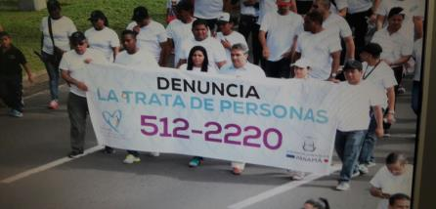
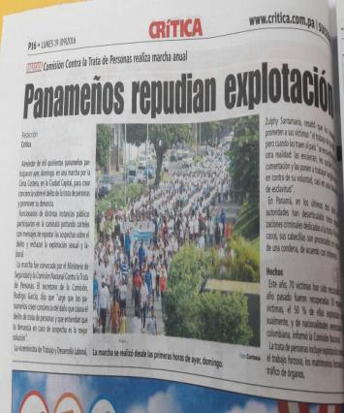
Strategic Theme1. Prevention and Awareness-Raising

Slide 11
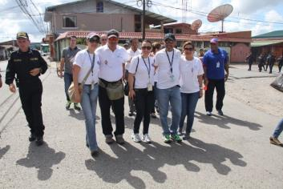
Binational Walk Costa Rica-Panama

Slide 12
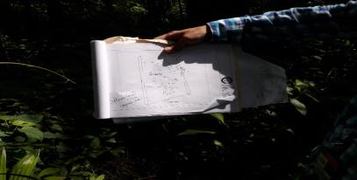
2. Assistance and Protection for Victims

Slide 13
2. Assistance and Protection for Victims

Slide 14
Prosecution of the Crime

Slide 15
Prosecution of the Crime
Results from operations;
In 26 months of operation;
More than 120 victims rescued;
More than a dozen trafficking networks dismantled;
Traffickers prosecuted.
The Division Against Trafficking in Persons of the Department of Judicial Investigation (DIJ), in coordination with the Public Prosecutor’s Office.

Slide 16
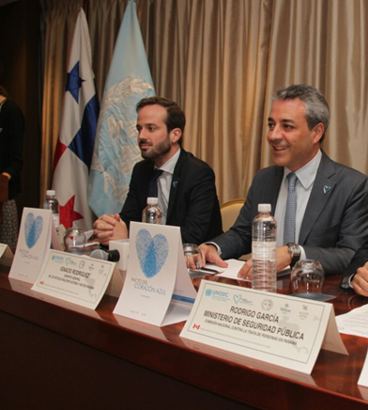
International Cooperation

Slide 17
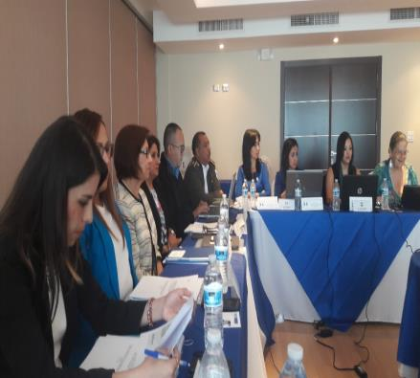
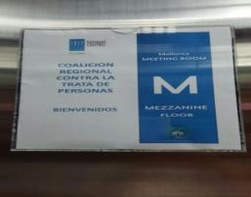
17th Meeting of the Regional Coalition

Slide 18
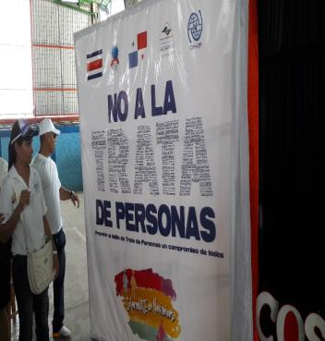
International Cooperation

Slide 19
Implementation, Follow-up and Monitoring Executive Decree Regulating Act 79 of 2011
National Policy Against Trafficking in Persons
The National Policy should define a set of values, principles and objectives of the State of Panama.
Commission in charge of developing a draft National Policy;
Notification period – Within six months prior to the expiration of the current Policy;
Draft submitted to the Directive Council for consideration and approval;
MINSEG will issue an Executive Decree;
The term of validity of the National Policy is 10 years.

Slide 20
Executive Decree Regulating Act 79 of 2011
National Plan Against Trafficking in Persons
A National Plan with a term of validity of 5 years: develops the required actions and strategies for:
Prevention;
Investigation;
Punishment.
And ensuring assistance and protection for victims and their families;
Includes institutions in charge of actions, terms and specific indicators to evaluate compliance.

Slide 21
Executive Decree Regulating Act 79 of 2011
Permanent Commissions, their establishment, duties of the members, functions, sessions and reporting:
Prevention, Dissemination and Awareness-Raising;
Assistance and Protection for Victims;
Prosecution of the Crime;
Information, Analysis and Investigation;
Cooperation in Terms of International Technical Assistance and Project Management.
Establishment of new special technical committees.

Slide 22
Executive Decree Regulating Act 79 of 2011
Special Units
Unit for Identification of and Assistance to Victims of Trafficking in Persons; and
Unit for Administration of Funds for
Victims of Trafficking.

Slide 23
National Commission Against Trafficking in Persons
General Secretariat
Email:
sgcntp@minseg.gob.pa
507-6983-3510
Hotline for reporting
trafficking in persons: 512-2220

