Slide 1
IOM International Organization for Migration
OIM Organización Internacional para las Migraciones
‘Capacity Building of Consular Authorities on Protection of the Labour Rights of Migrant Workers’
“Best Practices in Protecting Migrant Workers
in the Consular Sphere:
Policy Options for Countries of Origin”
Managua, Nicaragua - May 4, 2012
Ricardo Cordero
Regional Specialist on Labour Migration/Migration and Development
IOM Regional Office for Central America, North America, and the Caribbean
San José, Costa Rica

Slide 2
Protecting Migrant Workers
Should begin in the country of origin, with clear information on options to migrate and work in a regular and dignified manner;
Should continue in countries of destination: responsibility of preventing violations of the labour rights of migrant workers;
Cooperation between countries of origin and destination is essential in protecting migrant workers;
Diplomatic and consular representatives have various means to protect migrant workers.

Slide 3
G E N D E R
M
O
N
I
T
O
R
I
N
G
P
R
O
T
E
C
T
I
O
N
MO
N
I
T
O
R
O
2
Labour Market Strategy (labour market study)
3
International Cooperation
1
Migration Policy-making
4
Data Base and Records of Potential TMWs
TEMPORARY LABOUR MIGRATION CYCLE
8
Return and Reintegration
5
Information Dissemination
7
Working in the Country of Destination
6
Recruitment, Preparation, and Departure

Slide 4
How can Consulates Improve Protection for Migrant Workers?
Labour Attachés:
An officer of the Ministry of Labour working at embassies or consulates.
Key responsibilities:
Protecting migrant workers in his/her jurisdiction;
Supporting processes to identify decent employment opportunities for his/her compatriots;
Supporting the development of labour migration policy;
Promoting good relations with the host country in regard to labour matters.
Notes:
4

Slide 5
How Can the Protection for Migrant Workers be Improved in Countries of Destination?
Protection actions to be implemented by the Labour Attaché:
Assistance in matters relating to employment;
Protecting undocumented migrants and victims of trafficking;
Legal aid or representation at courts;
Knowledge and skills of the Labour Attaché:
International legislation;
Labour markets (origin and destination);
Labour policy and legislation (origin and destination);
Diplomatic skills, counselling;
Negotiation, conciliation, and arbitration.
The Labour Attaché coordinates his/her actions with the diplomatic mission and the Ministry of Labour in the country of origin.
Notes:
5

Slide 6
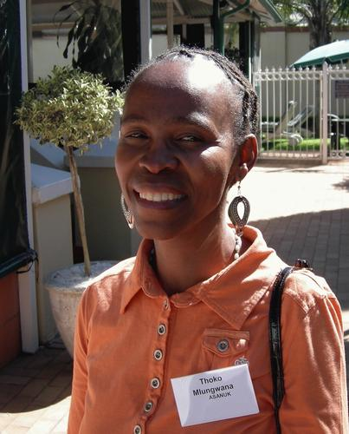
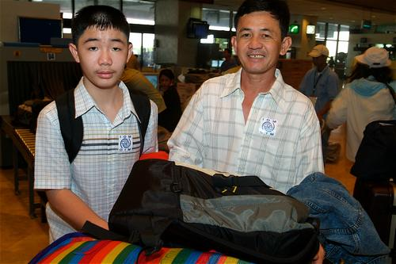
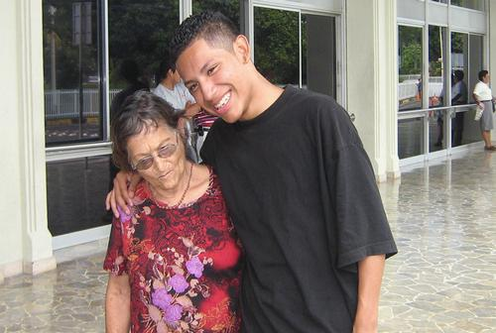
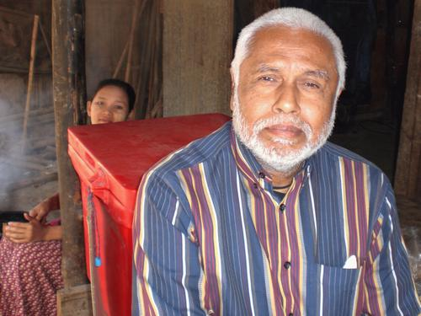
Best Practices in Consular Protection
The Case of the Philippines

Slide 7
Background
9 million Filipinos work overseas in approximately 190 countries (25% of the workforce).
An average of 75,000 Filipinos leave the country to work overseas each month.
30% of the marine workers worldwide are Filipinos.
The Philippines receives an average of US$ 1 billion each month in remittances (13% GDP).
The Overseas Employment Development Board (OEDB) is established in 1974 and transformed into the current Philippine Overseas Employment Administration (POEA) in 1982.
The Overseas Workers Welfare Administration (OWWA) is established in 1985.

Slide 8
The Comprehensive Migration Management Approach of the Philippines
Recruitment Regulation: Controls APR, explores the external labour market, disseminates information, appoints Labour Attachés at embassies and consulates, enters data into the data base (POEA).
Departure Process Administration: Organizes, coordinates, monitors, and evaluates the entire selection and preparation process before departure, issues identity documents, and enters data into the data base (POEA).
Protection and Representation: Conducts the mandatory orientation course prior to departure, provides guidance and services at embassies and consulates, enters data into the data base (OWWA-POEA).
Integrated Information System (Data Base): Centralizes and manages information on workers and employers, including remittances, to inform decision-making processes (POEA-OWWA-NEO).

Slide 9
Philippine Government Institutions Linked to
Migration Management
Ministry of Labour
Directorate of Employment
Ministry of Foreign Affairs
Directorate of Foreign Affairs
Overseas Workers Welfare Administration (OWWA)
Philippine Overseas Employment Administration (POEA)
Special Commission on Filipinos Overseas
Office of the Sub-Secretary for Filipinos Overseas
International Offices
International Offices
Embassies and Consulates
Social Welfare Officers
Labour Attachés
Foreign Service Staff
Filipino Workers Overseas

Slide 10
Services Provided Through Social Welfare Officers and Labour Attachés at Philippine Embassies and Consulates
Labour/legal aid, conciliation with employers
Representation before authorities in the country of destination
Information on options to send remittances
Information on investment, credit, and savings options in the country of origin
Replacing identity cards
Information about relatives in the country of origin
Repatriation in case of natural emergency situations or wars
Repatriation of bodies of deceased persons, financial assistance for funerals
Cultural events and integration activities in the country of destination
A scholarship programme for children of migrant workers
Visits to prisoners
A credit programme to initiate micro-enterprises in the Philippines

Slide 11
Policy Options for Countries of Origin
IOM • OIM
To incorporate protection of migrant workers and a gender approach as fundamental components of national migration policy;
To establish an inter-disciplinary team to develop public policy on labour migration;
To improve internal cooperation and bilateral and multilateral cooperation between countries of origin and destination;
To incorporate strong mechanisms and capacity building of foreign services to implement protection actions established in labour migration policies;
To ensure the existence of an adequate data collection and analysis and information dissemination system;
To conduct studies on the labour market in countries of origin and destination;
To develop programmes to stimulate the return and reintegration of temporary migrant workers;
To maximize the impact of remittances on local and national development.

Slide 12
Conclusion
Developing countries may face difficulties to allocate sufficient funds from the national budget to the protection of their migrant workers overseas.
Thus the need to consider co-financing mechanisms by migrants, employers, recruiting agencies, as well as strategic alliances with the private sector, NGOs, and international cooperation agencies.
Countries of origin should invest financial resources but, above all, political will is needed to ensure an appropriate labour migration management benefiting all the involved parties.
Notes:
12

Slide 13
Thank you
rcordero@iom.int

