Slide 1
U.S. Department of Homeland Security Unaccompanied Children
Acting Deputy Assistant Secretary Molly Groom
Department of Homeland Security
Office of Policy
Regional Conference on Migration
Meeting of the Regional Consultation Group on Migration
June 25 2014

Slide 2
Agenda
U.S. Definition of Unaccompanied Children
United States Legal Framework
Overview of the Current Situation
U.S. Government Response
Push and Pull Factors
Request for Assistance

Slide 3
Who are Unaccompanied Children
Unaccompanied Child, as defined in the Homeland Security Act of 2002 is a child who:
Has no lawful immigration status in the United States
Has not attained 18 years of age
Has no parent or legal Guardian in the United States; or
No parent or legal guardian in the United States is available to provide care and physical custody

Slide 4
U.S Legal Frameworks Governing Unaccompanied Children
U.S. law provides rights and protections to unaccompanied children within the U.S which include:
The Flores-Reno Settlement Agreement
The Homeland Security Act (2002)
The Trafficking Victims Protection Reauthorization Act (2008)
The Violence Against Women Reauthorization Act of 2013

Slide 5
Current Situation
The United States is seeing a more significant increase of unaccompanied children coming to the United States between the ports of entry.
In May alone, the number of unaccompanied children, crossing our southern border reached more than 9,000, bringing the total so far this year to 47,000.
To contrast, in Fiscal Year 2013 , the Department of Homeland Security apprehended more than 24,000 unaccompanied children at the border.
The problem is heavily concentrated along the South Texas border, and are primarily from countries Guatemala, Honduras and El Salvador.

Slide 6
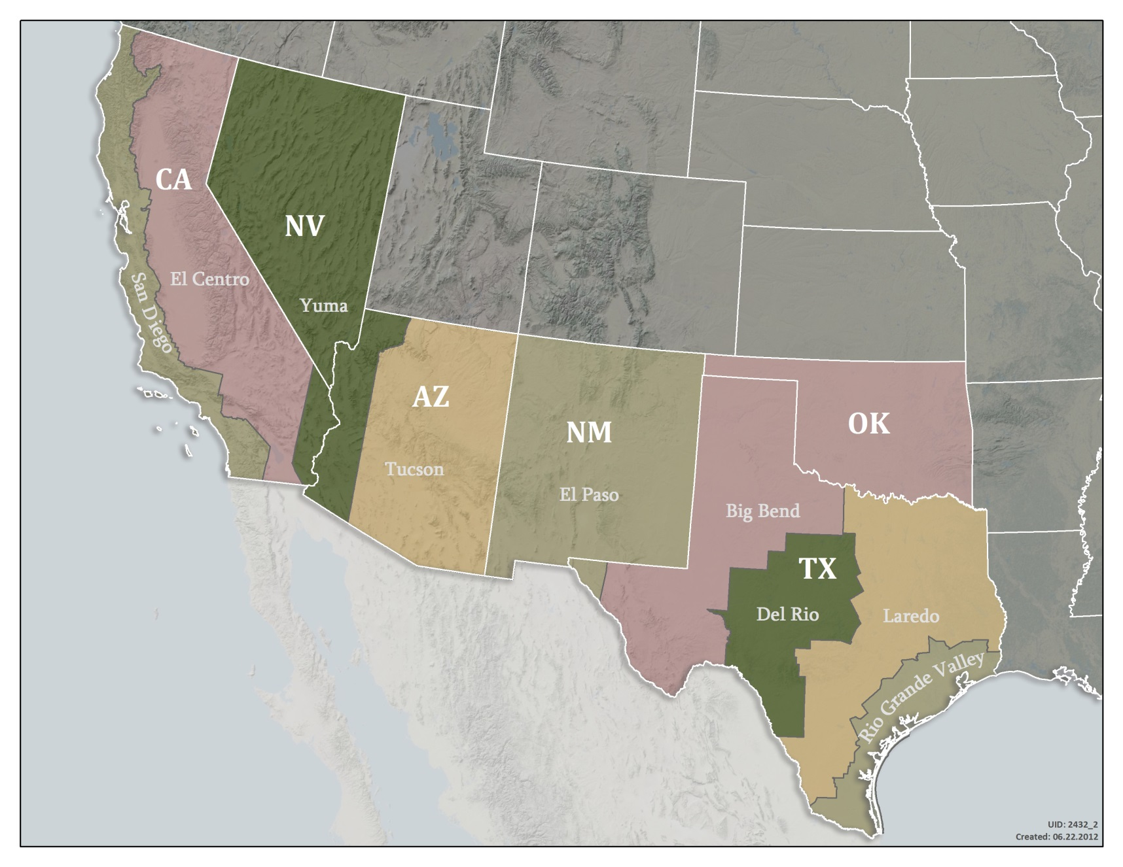
U.S. Southwest Border –Customs Border Protection Sectors

Slide 7
Current Situation
U.S. SOUTHWEST BORDER UNACCOMPANIED CHILDREN APPREHENSIONS
Fiscal Year 2013 and Fiscal 2014 through June 15
Sector | Fiscal Year 2013 | Fiscal Year 2014 | % Change﻿﻿
Big Bend Sector | 102 | 162 | 59%
Del Rio Sector | 1,476 | 2,637 | 79%
El Centro Sector | 315 | 444 | 41%
El Paso Sector | 559 | 742 | 33%
Laredo Sector | 2,654 | 2,986 | 13%
Rio Grande Sector | 13,532 | 37,621 | 178%
San Diego Sector | 439 | 706 | 61%
Tucson Sector | 6,930 | 6,619 | -4%
Yuma Sector | 199 | 276 | 39%
Southwest Border Total | 26,206 | 52,193 | 99%
http://www.cbp.gov/newsroom/stats/southwest-border-unaccompanied-children

Slide 8
Response to Surge
On May 11, Secretary Johnson traveled to McAllen, Texas to view the situation first hand and immediately declared a Level IV condition of readiness, which called for a Department of Homeland Security-wide response to assist with the children.
On June 2, President Obama directed the establishment of an interagency Unified Coordination Group to ensure unity of effort across the U.S government in responding to this significant influx of unaccompanied children across the Southwest border.

Slide 9
Whole of U.S. Government Response
Secretary Johnson designated Federal Emergency Management Agency (FEMA) Administrator Craig Fugate as the Federal Coordinating Official to lead and coordinate the Unified Command Group.
U.S. Government Participation:
White House
Department of Homeland Security
Department of Health and Human Services
Department of State
Department of Defense
General Services Administration
Other U.S. Government Agencies

Slide 10
Whole of U.S. Government Response
The U.S. Government is committed to
Ensuring a coordinated and rapid Government-wide response in the short-term
Undertaking broader, longer-term reforms to address the root causes behind these migration trends
The goal of this effort remains to quickly and safely move the unaccompanied children from the Department of Homeland Security custody into Department of Health and Human Services custody.
This offers a safe and secure environment that is in the best interest of the child, pursuant to the requirements of the law.

Slide 11
U.S. Government International Efforts
Secretary Johnson spoke with Ambassadors with additional continued staff-level engagement
Ongoing visits by Mexican and Central American officials to the border region to observe this crisis.
Vice President Biden Regional Visit on June 20
Continued to work with regional bodies such as Regional Conference on Migration
Upcoming visit by Secretary Johnson’s trip to Guatemala
Active engagement by U.S. Embassies with media, civil society, and host country counterparts

Slide 13
What We Know: Push Factors
Several reasons contribute to the dramatic increase in children migrating from Central America and crossing the border alone:
Poor economic conditions,
Increased and sustained violence in their home countries, and
The desire to be reunited with their families in the United States
Reasons are often reportedly combined

Slide 14
What We Know: Pull Factors
There are reports of growing misperception in sending countries that families and children who arrive may be provided legal status.
However, Deferred Action for Childhood Arrivals (DACA) is for those who came in to this country prior to 2007.
Likewise, the earned path to citizenship component of comprehensive immigration reform under consideration by Congress is for those in the U.S. before December 31, 2011.
Those who cross our borders illegally today, including children, are not be eligible for either DACA or an earned path to citizenship under comprehensive immigration reform.

Slide 15
We Need Your Help
Public Awareness/Prevention Campaigns
Seek your on the best way to the get message out about the dangers of the journey and identify counter falsehoods about the likelihood of status in the U.S.
Smuggling Networks
Identify and break-down smuggling networks
Protection, Repatriation, and Reintegration
Increase consular representation, especially along the Southwest border.
Enhance existing reception processes to ensure safe and efficient reintegration practices.

Slide 16
Questions and Answers
Thank you

